Slide 1
VCF Logs, Storage, and Network Operations

Slide 2
Importance
VCF Operations for logs helps organizations manage data at scale with centralized log management, and it provides deep operational visibility and intelligent analytics for troubleshooting and auditing across private, hybrid, and multicloud environments.
VCF Operations for logs delivers heterogeneous and highly scalable log management with intuitive, actionable dashboards, sophisticated analytics, and broad third-party extensibility. It provides administrators with a deeper look into the operations that occur in their physical, virtual, and multicloud environments. Administrators can use predictive analytics, machine learning, and root-cause analysis tools for faster problem resolution.

Slide 3
Module Lessons
VCF Operations for Logs Overview
VCF Storage Operations
VCF Network Operations

Slide 4
VCF Operations for Logs Overview

Slide 5
Learner Objectives
Describe the VCF Operations for logs overview
Describe the requirements for a log analytics solution
Describe the key benefits of VCF Operations for logs overview
Access the VCF Operations for logs UI

Slide 6
Log Analysis
The Log Analysis function in the VCF Operations console provides access to the required logs and relevant operational data in one place, eliminating the need to connect to several hosts to analyze logs.
The Log Analysis dashboard:
Displays the collected events from all VCF components with powerful queries and visualization charts
Enables grouping of events by type
Enables custom filter creation to focus analysis
Provides event trend analysis based on collected events
Notes:
TalkTrack:
The Log Analysis function in the VCF Operations console provides access to required logs and relevant operational data in one location, eliminating the need to connect to several hosts to analyze logs. The Log Analysis dashboard displays collected events from all VCF components with powerful queries and visualization charts. It also enables the grouping of events by type and custom filter creation to focus analysis. Furthermore, it provides event trend analysis based on collected events. The Operations Log Appliance must be deployed and integrated with VCF Operations to utilize the log analysis and diagnostic features. If this appliance is not configured, a message will appear indicating that the Operations Logs appliance must be accessed to use the VCF Operations log tools. VCF Operations for Logs is a log management tool that offers several benefits to administrators. It adds structure to all types of unstructured log data, enabling administrators to troubleshoot quickly and efficiently. It also allows administrators to derive insights from unstructured logs and event data in real time. The tool delivers real-time and archived log management across both physical and virtual environments.
<End>
The Operations Log Appliance must be deployed and integrated with VCF Operations to use the log analysis and diagnostic features. If not configured, a message appears that you must connect the Operations Logs appliance when you try to access the VCF Operations log tools.
VCF Operations for logs is a log management tool that provides the following benefits to administrators:
Adds structure to all types of unstructured log data, enabling administrators to troubleshoot quickly and efficiently
Enables administrators to make sense of unstructured logs and event data for real-time insights
Delivers real-time and archived log management across physical and virtual environments

Slide 7
VCF Operations Log Analysis Tools
You monitor the logs of the VCF components with log-based dashboards and an analysis tool in the VCF console. You can use the detailed filters to identify events and objects.
Creating your operation analysis:
Specify the refresh interval.
Query details and logs.
Specify the filter criteria and grouping.
Specify the visualization mode and type.
Notes:
TalkTrack:
The VCF Operations Log Analysis Tools allow for monitoring the logs of VCF components using log-based dashboards and analysis tools within the VCF console. Detailed filters can be utilized to identify events and objects. When creating an operation analysis, specific steps are involved. These include specifying the refresh interval, querying details and logs, defining the filter criteria and grouping, and determining the visualization mode and type. The VCF Operation Log Analysis widget offers enhanced visual capabilities for analyzing logs. The widget configuration allows for selecting one of the saved queries as an input for the widget or providing filters in place. Live monitoring and comprehensive charts assist with analysis and troubleshooting. The generated charts can be customized to provide a detailed and impactful visualization.
<End>
The VCF Operation Log Analysis widget provides enhanced visual capabilities of Analyze Logs. The widget configuration allows you to select from one of the saved queries as an input for the widget or provide filters in place.
Live monitoring and comprehensive charts assist analysis and troubleshooting.
The generated charts can be customized to provide a detailed and impactful visualization.

Slide 8
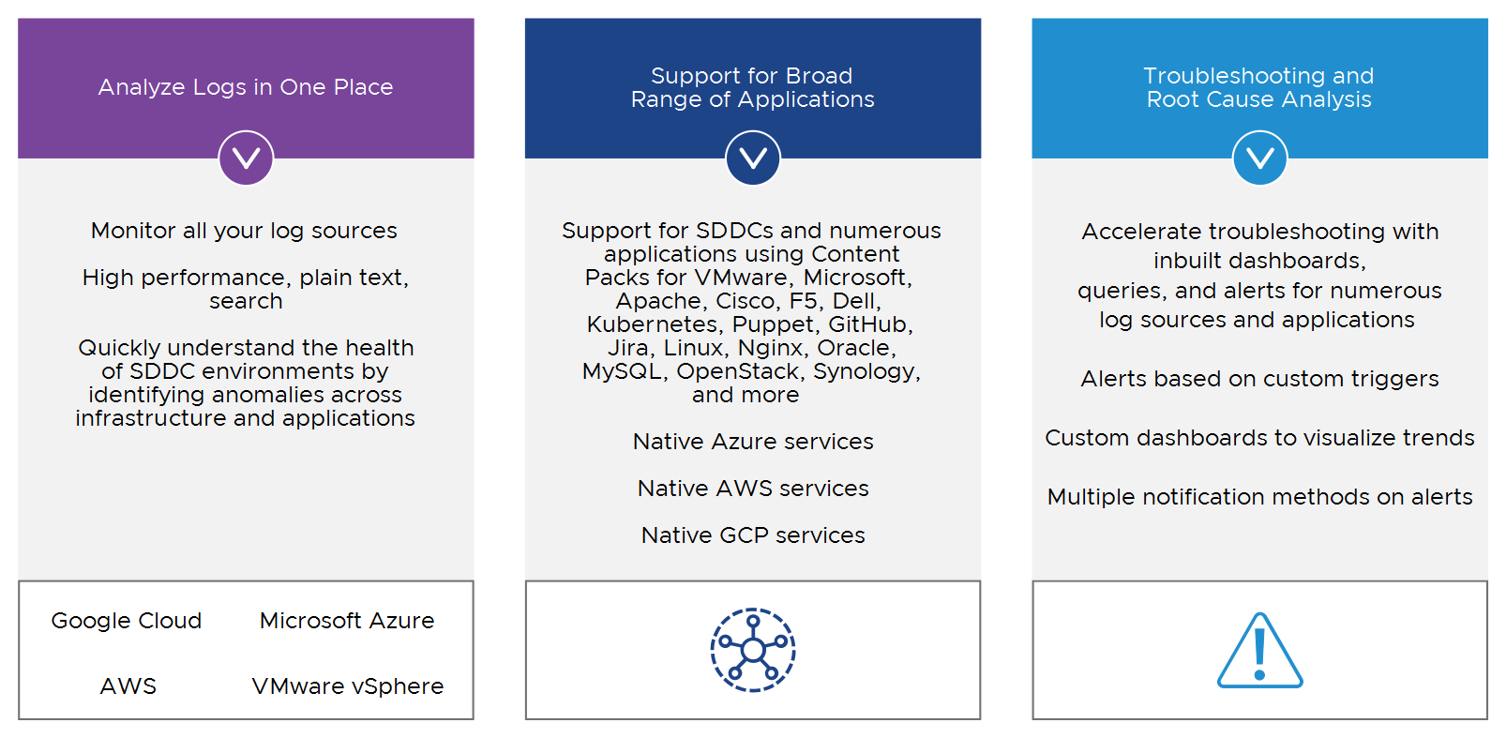
About VCF Operations for Logs
VCF Operations for logs is an intelligent log management platform for cloud, infrastructure, and applications.
Notes:
TalkTrack:
VCF Operations for Logs serves as an intelligent log management platform for cloud, infrastructure, and applications. The platform offers the ability to analyze logs in one central place. It enables monitoring of all log sources, provides high performance plain text search capabilities, and allows for quickly understanding the health of SDDC environments by identifying anomalies across infrastructure and applications. This includes support for Google Cloud, Microsoft Azure, and AWS, as well as VMware vSphere. Support for a broad range of applications is provided for SDDCs and numerous applications using Content Packs for various technologies, including Apache, Cisco, F5, Dell, Kubernetes, Puppet, GitHub, Jenkins, Microsoft SQL, MySQL, OpenStack, Spring, and more. It also supports native Azure services, native AWS services, and native GCP services. For troubleshooting and root cause analysis, the platform accelerates troubleshooting with out-of-the-box dashboards, queries, and alerts for numerous log sources and applications. Alerts can be based on custom triggers, and custom dashboards allow for visualizing trends. Multiple notification methods are available for alerts. VCF Operations for Logs delivers highly scalable log management with intuitive dashboards, sophisticated analytics, and extensive third-party extensibility, providing deep operational visibility and faster troubleshooting. This solution is available in an on-premises deployment. The system provides centralized log management, deep operational visibility, and intelligent analytics for better troubleshooting across over 200 log sources. Its advanced log-analytics capability can boost operational efficiency, mitigate costs arising from unplanned downtime, and reduce organizational risk through visibility into security-related events.
<End>
VCF Operations for Logs delivers heterogeneous and highly scalable log management with intuitive, actionable dashboards, sophisticated analytics, and broad third-party extensibility, providing deep operational visibility and faster troubleshooting. This solution is available in an on-premises deployment.
VCF Operations for Logs delivers centralized log management, deep operational visibility, and intelligent analytics for better troubleshooting and over 200 other log sources. With its advanced log-analytics capability, customers can boost operational efficiency, mitigate costs arising from unplanned downtime, and reduce organizational risk through visibility into security-related events.

Slide 9
Log-Based Alerts
You configure alerts to proactively identify potential problems, and implement preventive measures, ensuring maximum uptime of workloads:
Alerts created based on log entries across vSphere components.
Simplified alert creation using previously saved queries.
Triggered alerts, customized using time intervals, specific events, and thresholds.
Centralized location for alerts, metrics, and log queries, providing comprehensive monitoring and notification.
Notes:
TalkTrack:
Log-based alerts enable the proactive identification of potential problems and the implementation of preventative measures, ensuring maximum uptime of workloads. Alerts can be created based on log entries across vSphere components. Simplified alert creation is possible using previously saved queries. Triggered alerts can be customized using time intervals, specific events, and thresholds. A centralized location exists for alerts, metrics, and log queries, providing comprehensive monitoring and notification. New alerts can be defined based on log events over time. Unified alerts that combine metrics and log queries provide comprehensive monitoring and proactively identify potential problems for early issue detection.
<End>
You can now define new alerts based on logs. Alerts can be triggered based on log events over time. So unified alerts that combine metrics and log queries provide comprehensive monitoring and proactively identify potential problems for early issue detection.

Slide 10
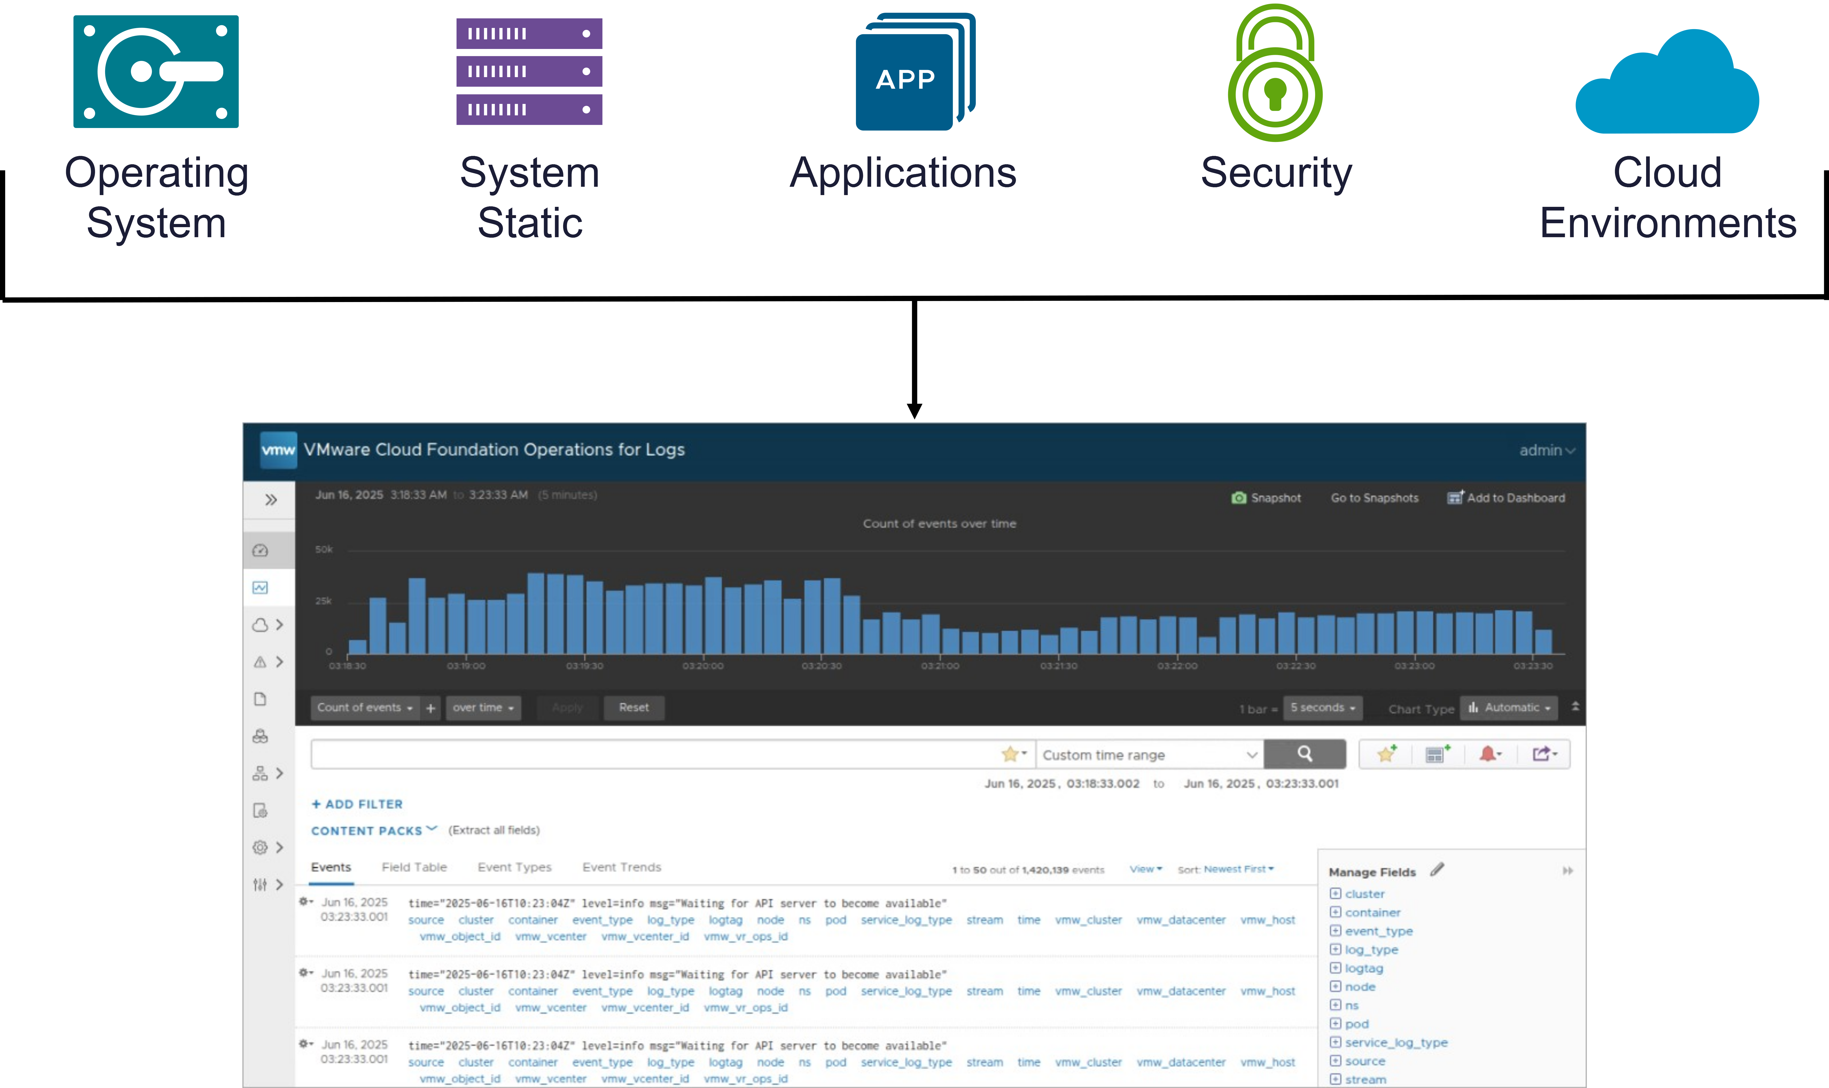
Importance of Efficient Log Management
VCF Operations for logs provides a single location to collect, store, and analyze unstructured data at scale from operating systems, applications, storage, network devices, and more:
All significant data center events are recorded and saved in log files.
The data in log files is typically vast and unstructured, making the interpretation of log files challenging.
Filtering and reviewing logs can be difficult and time-consuming.
Notes:
TalkTrack:
Efficient log management is crucial for operational visibility and troubleshooting. VCF Operations for Logs provides a centralized location to collect, store, and analyze unstructured data from operating systems, applications, storage, network devices, and more. All significant data center events are recorded and saved in log files, but the data is typically vast and unstructured, making interpretation of log files challenging. Filtering and selecting logs for analysis can also be difficult and time-consuming. Traditional management tools focus on monitoring data center operational states. These tools might indicate poor performance or exceeding thresholds, but they often only alert when an issue exceeds a predefined limit. They typically do not help identify the root causes of problems or analyze logs to determine the staff required. All significant data center events are recorded and saved in log files, providing visibility into the affected applications, systems, and security. Log files identify specific events and help track the causes of problems. Effective management of these logs can help with security, compliance, and troubleshooting activities performed in a cloud platform environment. Interpreting log data can be challenging due to its unstructured nature and the sheer volume of information generated daily. Without efficient log management, the lack of prompt attention to configuration, security, and performance problems puts data center at risk. This can lead to increased downtime for applications and servers, and potentially expose the environment to malicious attacks and unauthorized log access.
<End>
Traditional management tools focus on monitoring data center operations. These management tools rely on real-time performance metrics, and they alert IT staff only when the metrics exceed a set point. Traditional management tools do not analyze logs to identify the root causes of problems or analyze logs to alert IT staff of impending problems.
All significant data center events are recorded and saved in log files: All significant data center events affecting applications, systems, and security are recorded and saved in log files. Log files identify log file events and help track the causes of problems. Log files, when effectively managed, help with security, compliance, and troubleshooting activities performed in a cloud platform environment.
The data in log files is typically vast and unstructured, making the interpretation of log files challenging. One problem with log files is that the data is unstructured, and so many events are created that it is difficult to filter for the key information that is required for decision making. It can take a lot of time to use the log information effectively. Without log management, the lack of prompt attention to security and the failure to respond to configuration and performance problems put the data center at risk of increased downtime for applications and servers, in addition to malicious attacks and unauthorized logins.
Without log management, the lack of prompt attention to configuration, security, and performance problems puts the data center at risk.

Slide 11
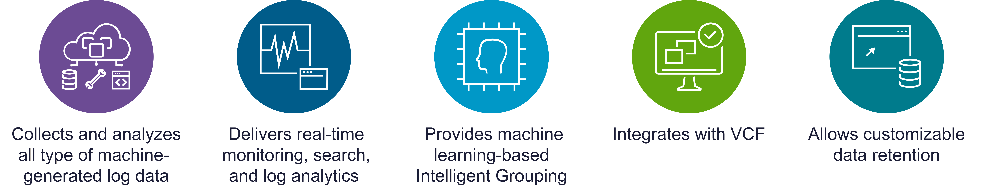
Key Capabilities of VCF Operations for Logs
VCF Operations for logs collects, imports, and analyzes logs to provide answers to problems related to systems, services, and applications, and derive important insights.
Notes:
TalkTrack:
Key capabilities of VCF Operations for Logs include collecting, importing, and analyzing logs to address problems related to systems, services, and applications, and to derive important insights. The system offers collection and analysis of all types of machine-generated log data, such as application logs, network traces, configuration files, messages, performance data, and system state dumps. VCF Operations for Logs delivers real-time monitoring, search, and log analytics, in addition to a dashboard for stored queries and alerts. This enables administrators to correlate events across the IT environment. The platform also provides machine learning-based Intelligent Grouping, which enables high-performance searching for faster troubleshooting across physical, virtual, and cloud environments. Integration with VMware Aria Operations brings unstructured and structured data together, providing enhanced end-to-end operations management. The data retention policy in VCF Operations for Logs allows organizations to plan and customize data retention. As a result, organizations can improve compliance with license agreements and internal security policies and avoid unnecessary storage consumption.
<End>
Some of the key capabilities offered by Key Capabilities of VCF Operations for Logs are as follows:
Collection and analysis of all types of machine-generated log data, such as application logs, network traces, configuration files, messages, performance data, and system state dumps.
VCF Operations for Logs delivers real-time monitoring, search, and log analytics in addition to a dashboard for stored queries, reports, and alerts. This enables administrators to correlate events across the IT environment.
VCF Operations for Logs provides machine learning-based Intelligent Grouping, which enables high-performance searching for faster troubleshooting across physical, virtual, and cloud environments.
The integration of VCF Operations for Logs with VMware Aria Operations brings unstructured and structured data together, which provides an enhanced end-to-end operations management.
The data retention policy in VCF Operations for Logs allows organizations to plan and customize data retention. As a result, organizations can improve compliance with license agreements and internal security policies and avoid unnecessary storage consumption.

Slide 12
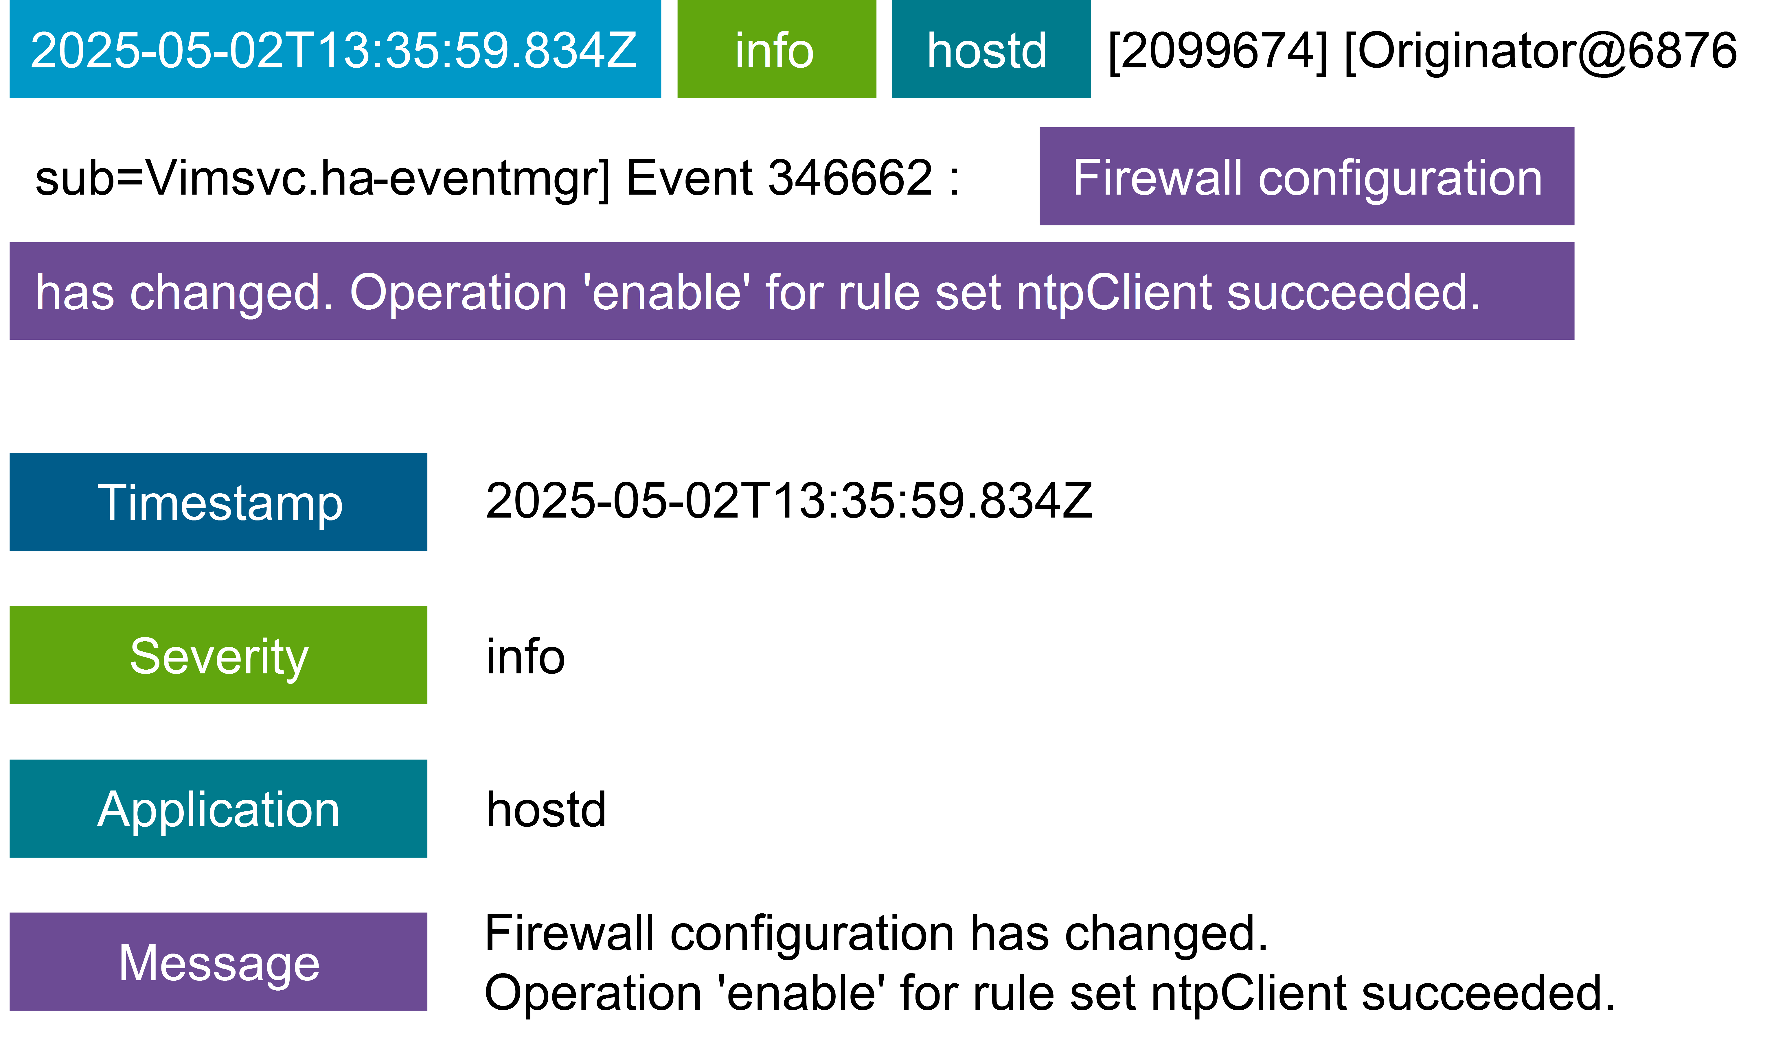
Anatomy of Log Messages
A log file message has unstructured text.
Notes:
TalkTrack:
A log file message consists of unstructured text. Log files contain information that can provide faster troubleshooting, improved decision-making, and enhanced security. When reviewing a log event, its importance and the reported information must be considered. Log events contain specific information. This includes a timestamp, which indicates when the event occurred. The source of the event is also provided, indicating the originator of the Syslog message, such as an ESX host, a forwarder, or a Syslog aggregator. The raw text of the event is available. Finally, name-value pairs extracted from the event are included. These fields are delivered to the server as static fields only when an agent uses the Collection Framework API, or CFAPI protocol.
<End>
Log files contain information that can help provide faster troubleshooting, improved decision-making, and enhanced security. You must consider when the event occurs, its importance, and the reported information. Log events contain the following information:
Time stamp: Time when the event occurred
Source: Origin of the event
The source might be the originator of the Syslog messages, such as an ESX host, or a forwarder, such as a Syslog aggregator.
Text: Raw text of the event
Fields: Name-value pairs extracted from the event
Fields are delivered to the server as static fields only when an agent uses the Collection Framework API (CFAPI) protocol.

Slide 13
Integrating Logs in the VCF Operations Console
VCF 9.0 converges the Aria logs and the VCF Operations user experience for managing and analyzing log data for the VCF environment:
Log Analysis
Log Compare
Log widgets
Dashboard framework ability to create log-based alerts
Cloud proxy enhancements data sets in RBAC
Notes:
TalkTrack:
In VCF 9.0, Aria logs and VCF Operations user experience converge for managing and analyzing log data within the VCF environment. This integration encompasses several key areas. These include enhanced log analysis capabilities and log comparison features. Log widgets are now integrated into VCF Operations. The dashboard framework provides the ability to create log-based alerts within VCF Operations. Additionally, Cloud Proxy enhancements have been made to data sets in RBAC.
<End>

Slide 14
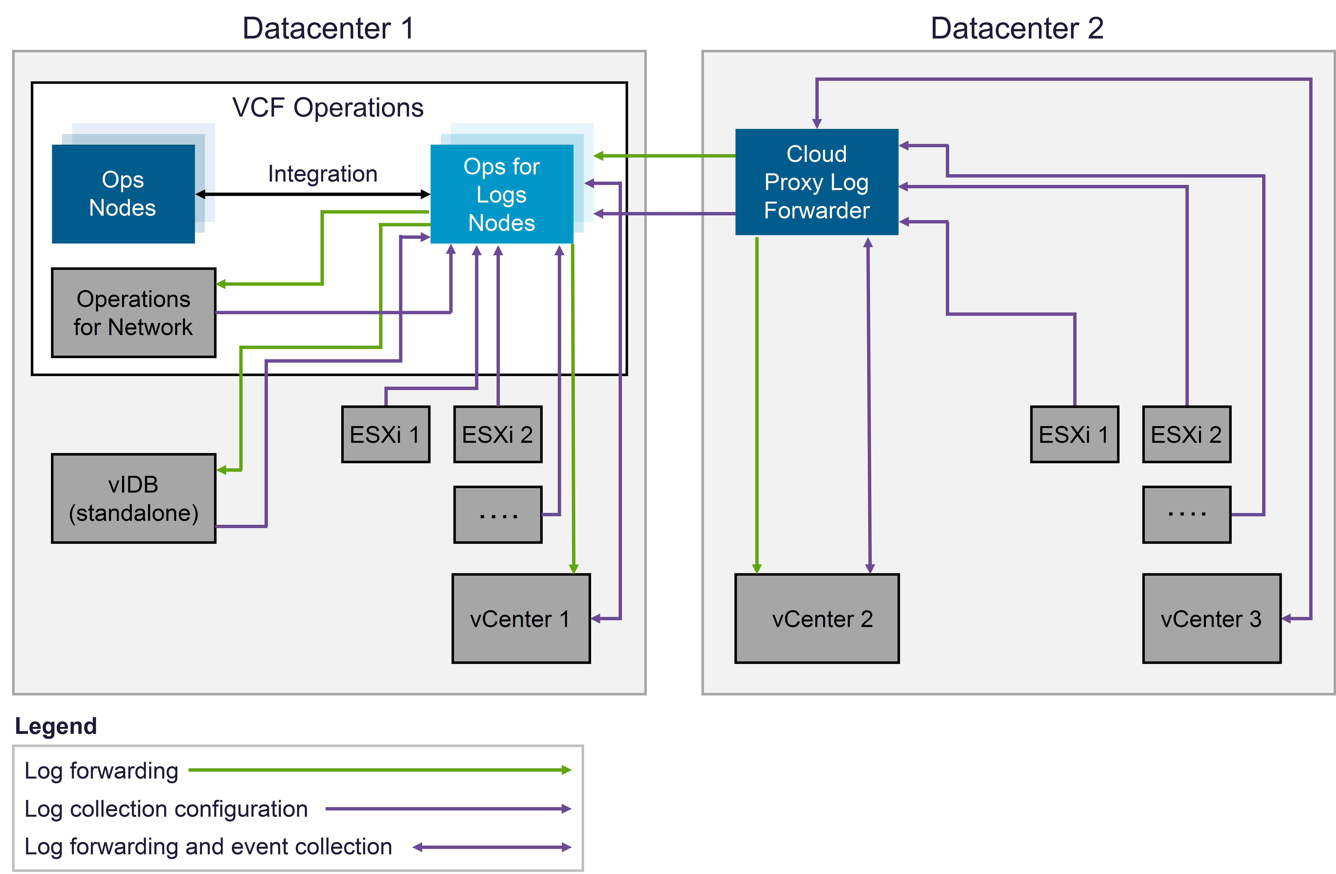
Log Collection Configuration Architecture
The new centralized logs collection architecture provides the benefits of log collection across different VMware Cloud Foundation components, granular log configuration, and cross data center log collection.
Notes:
TalkTrack:
The new centralized log collection architecture provides benefits for log collection across different VMware Cloud Foundation components, granular log configuration, and cross-data center log collection. The high-level diagram illustrates the components involved in the centralized log collection. To implement this, VCF Operations and VMware Cloud Foundation Operations for logs must be integrated. VCF Operations provides centralized management for log collection across all VMware Cloud Foundation components. It also supports diagnostic and monitoring features that rely on these logs. The log collection configuration is stored in the VMware Cloud Foundation Operations for logs cluster, but updates are always initiated through VCF Operations. Regardless of whether logs are forwarded via the Cloud Proxy log forwarder or directly sent to the VMware Cloud Foundation Operations for logs cluster, the centralized configuration is managed from the VMware Cloud Foundation Operations for logs cluster, ensuring consistency across the environment.
<End>
The high-level diagram of the collection configuration is provided above.
To implement this setup, VCF Operations and VMware Cloud Foundation Operations for logs must be integrated. VCF Operations provides centralized management for log collection across all the VMware Cloud Foundation components. It also supports diagnostic and monitoring features that rely on these logs.
The log collection configuration is stored in the VMware Cloud Foundation Operations for logs cluster, but updates are always initiated through VCF Operations.
Irrespective of whether logs are forwarded via the Cloud Proxy log forwarder, or sent directly to the VMware Cloud Foundation Operations for logs cluster, the centralized configuration is managed from the VMware Cloud Foundation Operations for logs cluster, ensuring consistency across the environment.

Slide 15
About the Agent
The Agent is preinstalled in the supported VMware Cloud Foundation components.
The Agent offers key benefits:
Centralized configuration
Life cycle management
Log enhancement
Notes:
TalkTrack:
The Agent is pre-installed in supported VMware Cloud Foundation components and offers several key benefits. Centralized configuration is a primary advantage. Once the Agent establishes a connection to its server, it automatically retrieves and applies configuration settings. These settings are based on defined Agent Groups or Content Packs. Lifecycle management is another benefit. The Agent can update itself by downloading the latest version directly from its server. Finally, log enhancement is provided. The Agent can add static information, such as application name or file path, to logs. This type of information is typically missing in traditional syslog data.
<End>
Centralized Configuration: Once the Agent is connected to its server, it automatically retrieves and applies configuration settings based on defined Agent Groups or Content Packs.
Lifecycle Management: The Agent can update itself by downloading the latest version directly from its server.
Log Enhancement: The Agent can add static information (e.g., application name or file path) to logs, which is typically missing in traditional syslog data.

Slide 16
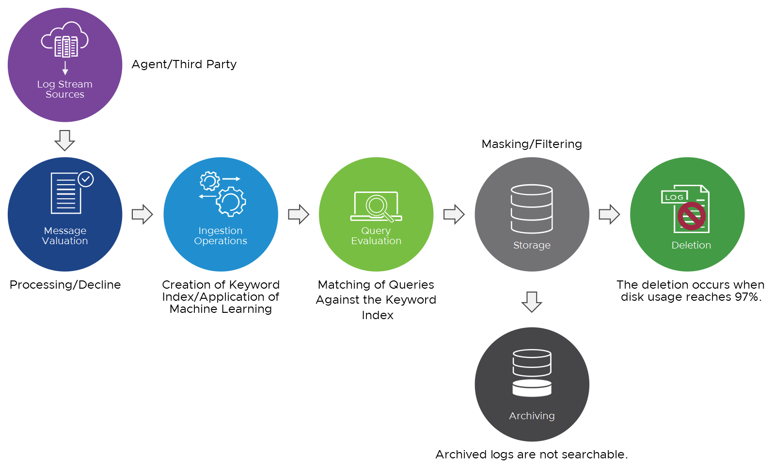
Stages of Log Processing
Events and messages transition through several stages.
Notes:
TalkTrack:
Events and messages transition through several stages during log processing. First, a device generates a log file. This file is then picked up and sent to VCF Operations for logs in one of three ways: by an agent using the Ingestion API or Syslog, by an agent using the Ingestion API, or through third-party agents such as rsyslog, syslog-ng, or log4j using Syslog. Next, VCF Operations for logs receives the events. If the organization uses an integrated load balancer, the event is directed to a single node responsible for processing it. Once the event is accepted, the client is notified. The event then passes through the ingestion pipeline, where several steps occur. A keyword index is created or updated, with the index stored in a proprietary format on a local disk. Machine learning is applied to cluster events. The event is stored in a compressed proprietary format on the local disk within a bucket. The event is queried in the following ways: through keyword and glob queries matched against the keyword index, and through regex matches against compressed events. Finally, the event is moved to a bucket. This bucket can be deleted or archived when disk usage reaches 97 percent capacity or the bucket size reaches 500 MB. Buckets operate on a FIFO order, and the oldest events are overwritten. It is important to monitor system alerts and notify estimated retention based on ingestion rate. Archived logs are not searchable, and they cannot be imported using the Log Importer. If archiving is configured, logs are archived instead of being deleted. Data stored by VCF Operations for logs is immutable, and after a log is imported or ingested, it cannot be removed until it is automatically retired. Further information about log storage policy is available in a documented administration policy for VCF Operations for logs.
<End>
A detailed workflow of the stages of log processing is as follows:
A device generates a log file. The log file is picked up and sent to VCF Operations for logs in one of the following ways:
By an agent using the Ingestion API or Syslog
Through third-party agents such as rsyslog, syslog-ng, or log4j using Syslog
VCF Operations for Logs receives the event:
If the organization is using the integrated load balancer, the event is directed to a single node that is responsible for processing the event.
If the event is accepted, the client is notified.
The event is passed through the ingestion pipeline, in which the following steps occur:
A keyword index is created or updated. The index is stored in a proprietary format on a local disk.
Machine learning is applied to cluster events.
The event is stored in a compressed proprietary format on the local disk in a bucket.
The event is queried in the following ways:
Keyword and glob queries are matched against the keyword index.
Regex is matched against compressed events.
The event is moved to a bucket. It can be deleted or archived when disk usage is at 97 percent capacity. A bucket is sealed when it reaches 500 MB.
Buckets are deleted in FIFO order and the oldest events are overwritten. It is important to monitor system alerts and notify estimated retention based on ingestion rate.
Archived logs are not searchable. They cannot be imported using the Log Importer. If archiving is configured, logs are archived instead of being deleted.
Data stored by VCF Operations for logs is immutable. After a log is imported or ingested, it cannot be removed until it is automatically retired.
See the section about log storage policy in Administering VCF Operations for logs at https://techdocs.broadcom.com/us/en/vmware-cis/vcf/vcf-9-0-and-later/9-0/infrastructure-operations/log-analysis.html.

Slide 17
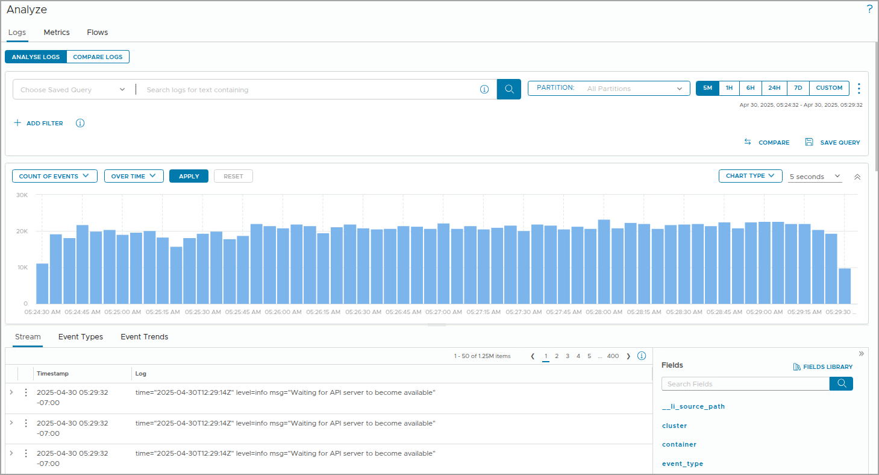
About the Analyze Page
The Explore Logs page enables you to view log messages, determine problem areas, and perform root cause analysis.
Notes:
TalkTrack:
The Explore Logs page provides functionality to view log messages, determine problem areas, and perform root cause analysis. The Explore Logs page offers various features that enable a focused examination of key elements emerging from a particular line of inquiry. With diverse display options, events can be efficiently discovered, and their impact on systems in the data center can be understood. One can search and filter log events on this page to find only entries that contain specified keywords. Any complete keywords, globs, or phrases can be entered into the search box, followed by clicking the search button. The time range can be specified by clicking on the dashboards or Explore Logs pages in the web user interface. Time ranges are inclusive when filtering. Log events can be searched to match specific values of fields. Using quoted text in the main search field matches exact phrases. Entering a space in the main search field acts as a logical AND operator. The search uses only full tokens. For instance, searching for "err" does not find "error" as a match.
<End>
The Explore Logs page has a variety of features that enable you to focus on the key elements that emerge from a particular line of inquiry. With different ways to display information, you can efficiently search for events and discover when and how they affect the systems in your data center.
You can search and filter log events in the Explore Logs page. To find only events that contain specified keywords, enter any complete keywords, globs, or phrases in the search box and click Search.
You can specify the time range on either the Dashboards or Explore Logs pages in the web UI. Time ranges are inclusive when filtering.
You can search for log events that match certain values of specific fields. Using quoted text in the main search field matches exact phrases. Entering space in the main search field is a logical AND operator. The search uses only full tokens. For example, searching for "err" does not find "error" as a match.

Slide 18
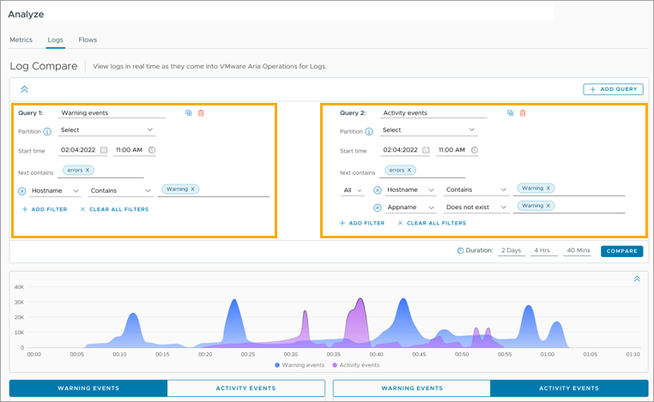
About Log Compare
With the Log Compare feature, you can compare logs from different time periods or log sources to identify anomalies.
Notes:
TalkTrack:
The Log Compare feature allows for comparing logs from different time periods or log sources to identify anomalies. Key features and benefits of Log Compare include determining new releases or changes that might have introduced new issues by reviewing differences in log streams. It is possible to compare up to four log streams simultaneously. Swift issue resolution is achieved through side-by-side comparison. The feature also provides advanced filters and visualization charts.
<End>
Here are some key features and benefits of Log compare:
Determine new release or changes introduced new issues by reviewing difference in log streams.
Compare up to four log streams simultaneously.
Swift issue resolution through side by side comparison.
Advanced filters and visualization charts.

Slide 19
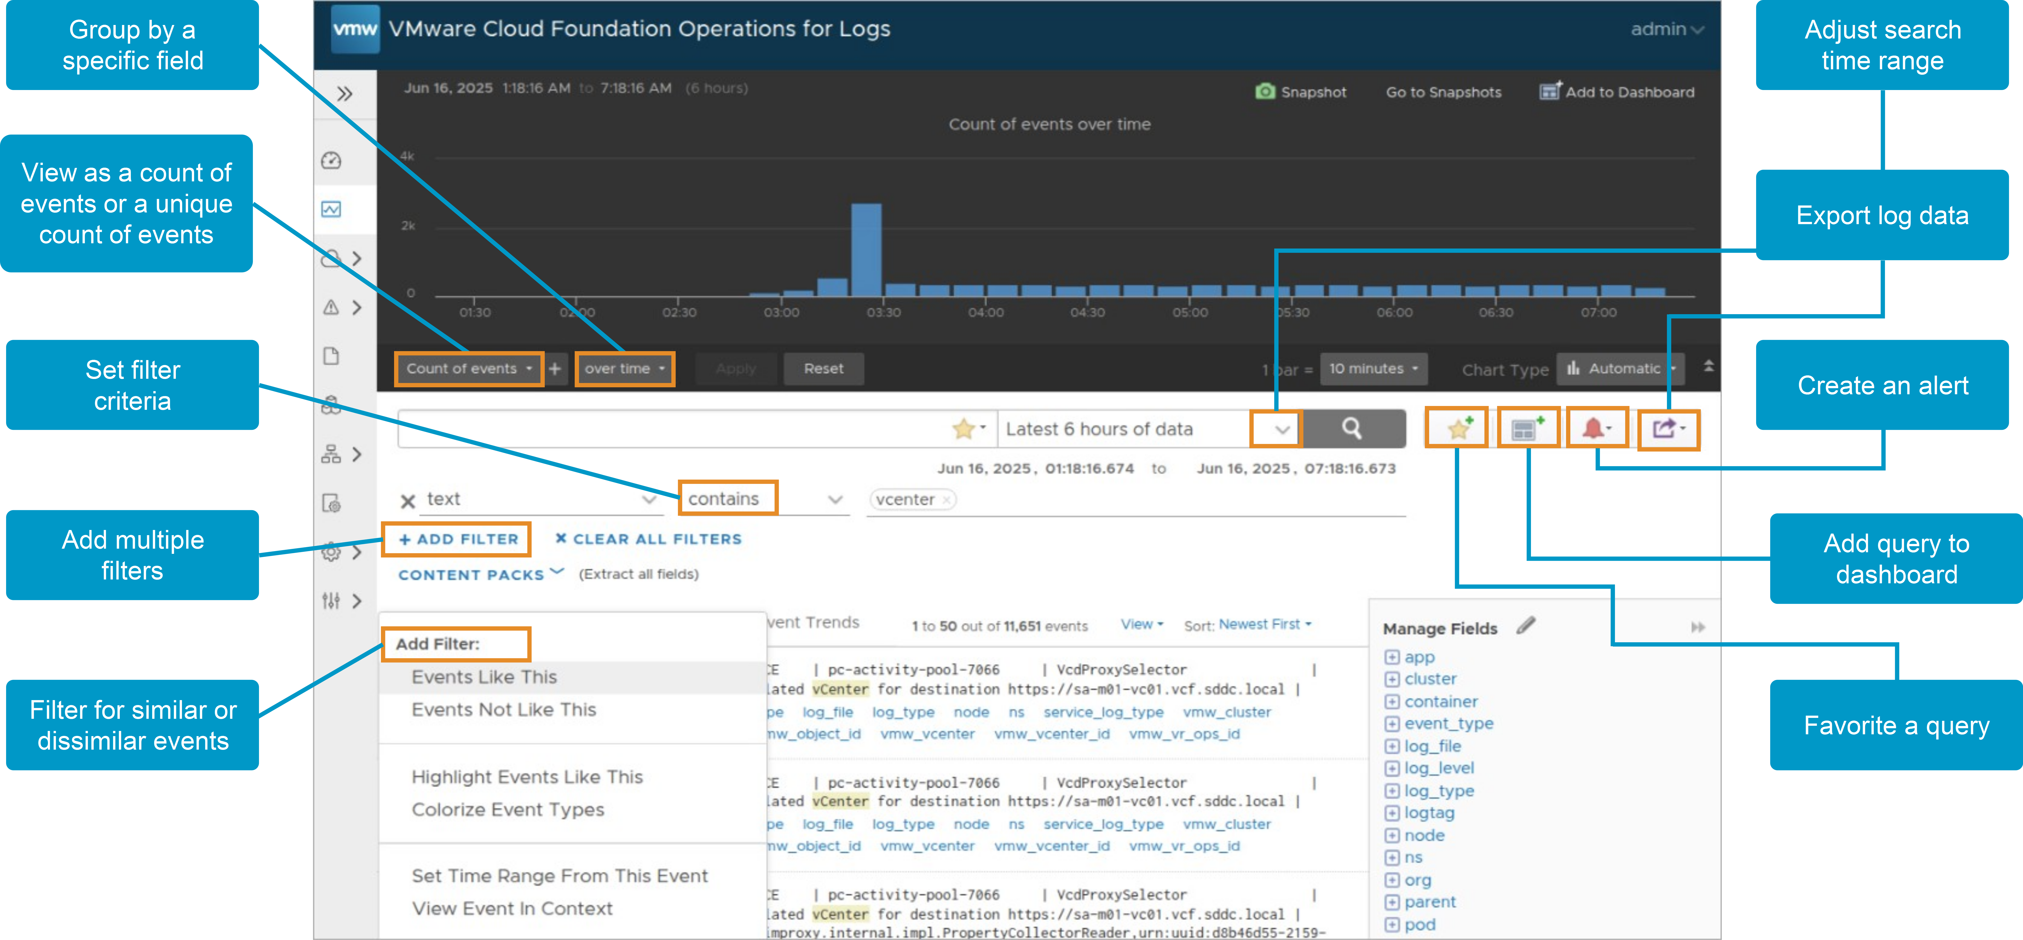
About the Explore Logs Page
The Explore Logs page enables you to view log messages, determine problem areas, and perform root-cause analysis.
Notes:
TalkTrack:
The Explore Logs page provides functionality to view log messages, determine problem areas, and perform root cause analysis. The Explore Logs page offers various features that enable a focused examination of key elements emerging from a particular line of inquiry. With diverse display options, events can be efficiently discovered, and their impact on systems in the data center can be understood. One can search and filter log events on this page to find only entries that contain specified keywords. Any complete keywords, globs, or phrases can be entered into the search box, followed by clicking the search button. The time range can be specified by clicking on the dashboards or Explore Logs pages in the web user interface. Time ranges are inclusive when filtering. Log events can be searched to match specific values of fields. Using quoted text in the main search field matches exact phrases. Entering a space in the main search field acts as a logical AND operator. The search uses only full tokens. For instance, searching for "err" does not find "error" as a match.
<End>
The Explore Logs page has a variety of features that enable you to focus on the key elements that emerge from a particular line of inquiry. With different ways to display information, you can efficiently search for events and discover when and how they affect the systems in your data center.
You can search and filter log events in the Explore Logs page. To find only events that contain specified keywords, enter any complete keywords, globs, or phrases in the search box and click Search.
You can specify the time range on either the Dashboards or Explore Logs pages in the web UI. Time ranges are inclusive when filtering.
You can search for log events that match certain values of specific fields. Using quoted text in the main search field matches exact phrases. Entering space in the main search field is a logical AND operator. The search uses only full tokens. For example, searching for "err" does not find "error" as a match.

Slide 20
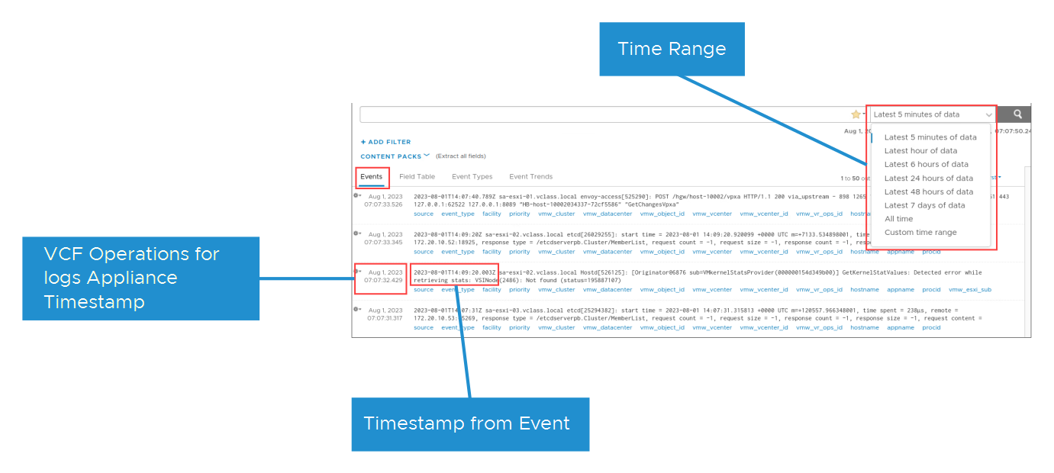
About Timestamps
Timestamps are critical to analyzing events. VCF Operations for logs uses the appliance time stamp when the incoming data is ingested.
Notes:
TalkTrack:
Time stamps are crucial for effective log analysis. VCF Operations for logs assigns the appliance time stamp when incoming data is ingested. The time stamp displayed in gray indicates the time stamp that VCF Operations for logs added when the message was ingested. Time zone differences are accounted for when the data is ingested. It is necessary to determine the time of the event before analyzing it. VCF Operations for logs records and reports the Syslog stamp and the time the event occurred. The time stamp in gray might show a small discrepancy from the time stamp within the event itself.
<End>
The time stamp in gray is the time stamp that VCF Operations for logs added when the message was ingested. Time zone differences are accounted for when the data is ingested.
You must determine the time of the event before analyzing it. VCF Operations for logs records and reports the Syslog stamp and the time when the event was ingested. The time stamp in gray might have a small discrepancy from the time stamp from the event.

Slide 21
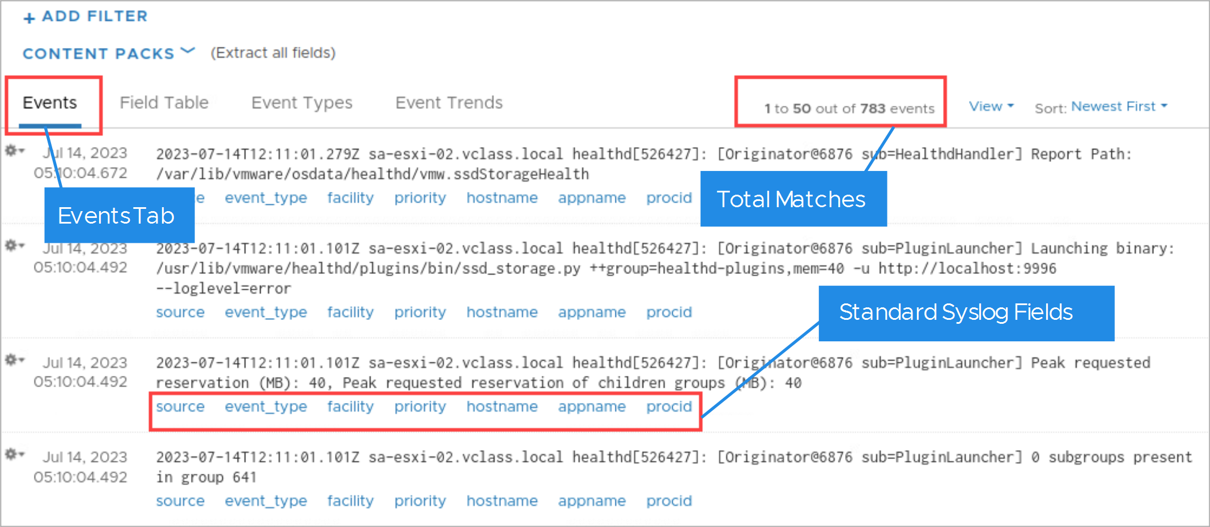
Event List
Events are assigned fields when they are ingested. These fields are standard Syslog fields, or they are predefined from a content pack.
Notes:
TalkTrack:
Events are assigned fields when they are ingested. These fields are standard Syslog fields or are predefined from a content pack. After performing a search on the events list, the search results remain until all queries are cleared. An event consists of event fields. Event fields are either standard Syslog fields, fields described by content packs, fields defined by users, or fields identified by machine learning. Fields that are identified by machine learning are called smart fields. The names of the event fields appear in blue in the list of events under each event.
<End>
After you perform a search on the events list, the search results remain until you clear all queries.
An event consists of event fields. Event fields are either standard Syslog fields, fields described by content packs, fields defined by users, or fields identified by machine learning. Fields that are identified by machine learning are called smart fields. The names of the event fields appear blue in the list of events under each event.

Slide 22
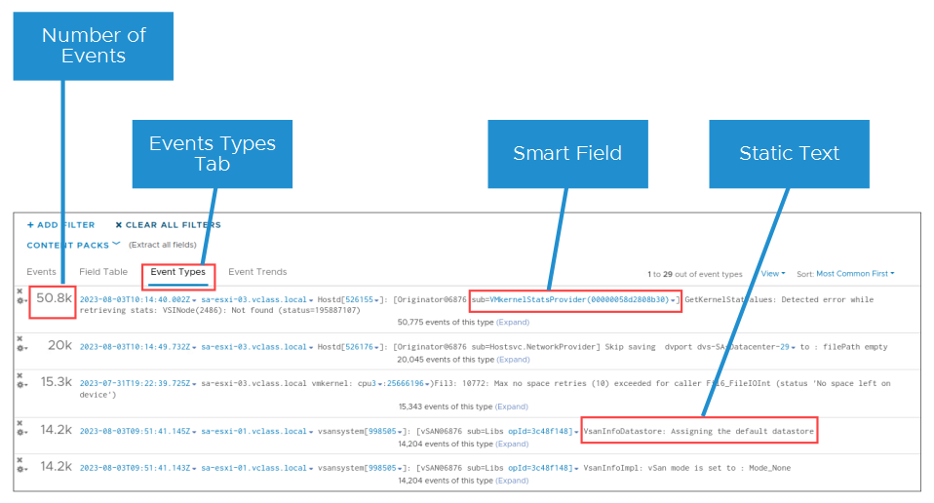
Event Types
Event types (smart fields) are fields that are automatically extracted and categorized by VCF Operations for logs. Static fields have black text, whereas event fields have blue text.
Notes:
TalkTrack:
Event types, often referred to as smart fields, are fields automatically extracted and categorized by VCF Operations for logs. Static fields are displayed with black text, while event fields are shown with blue text. VCF Operations for logs uses machine learning to group several individual events into broader event types. Each group includes the approximate number of events within that group. Grouping events helps identify both the most communicative events and the quietest ones, both of which are critical for troubleshooting. Event types can also be used to quickly scope log messages and eliminate irrelevant log messages. Each event type discovered by machine learning yields a smart field. These smart fields can be renamed or deleted, but their default definition cannot be modified. The default name of a smart field follows the format of smart_field_type_number_[event_type]. Static portions of the event appear in black. They are highlighted when the pointer is moved to the associated event field.
<End>
VCF Operations for logs summarizes several individual events into smaller broad event types. VCF Operations for logs uses machine learning to group similar events together. Each group has the approximate number of events in the group. Grouping events helps identify the most communicative events and the quietest ones, both of which are critical for troubleshooting. Event types can also be used to quickly scope log messages and eliminate irrelevant log messages.
Each event type that machine learning discovers represents a smart field. You can rename or delete a smart field, but you cannot modify its definition. The default name of a smart field has the following format: smart field type number [event_type].
Static portions of the event appear in black. They are highlighted when you point to the associated event field.

Slide 23
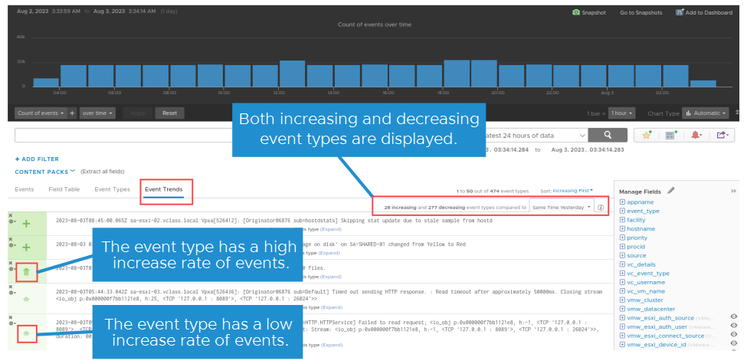
Event Trends
You can use the Event Trends tab to analyze the log events for trends and anomalies with the event history.
Notes:
TalkTrack:
The Event Trends tab allows for analyzing log events to identify trends and anomalies within the event history. Both increasing and decreasing event types are displayed. Event trends provide specific types of information. This includes increasing and decreasing event types, along with their respective rates of increase and decrease. Event types with newly added events to the system are shown, which assists in identifying unexpected behavior. Event types that are arriving at a constant rate are also displayed. Finally, information is available for event types that are no longer present in the system.
<End>
Event trends show the following information:
Increasing and decreasing event types and the increase and decrease rates for events
Event types with events newly added to the system, which helps to identify unexpected behavior
Event types with events arriving at a constant rate
Event types with events that are no longer in the system

Slide 24
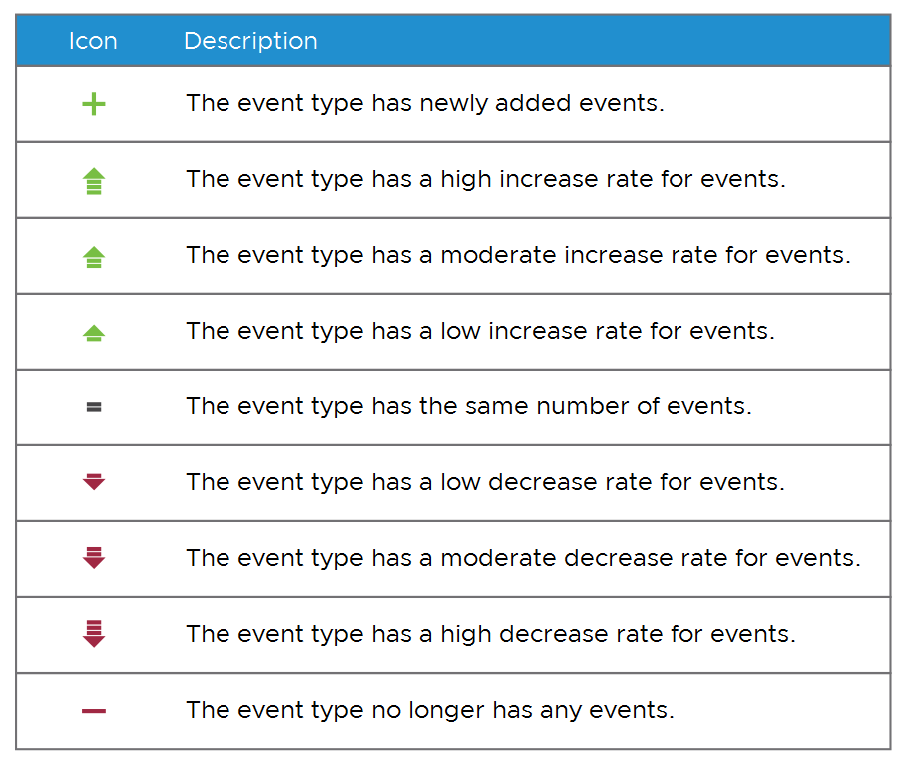
Event Trends Legend
Event trends use the following icons for new, existing, and deleted events in each event type, comparing the current event rate to the event rate at the time that you select in the first drop-down menu. You can point to these icons to view the increase and decrease rates.
Notes:
TalkTrack:
Event trends use specific icons to represent new, existing, and deleted events in each event type. These icons compare the current event rate to the event rate at a previously selected time. Pointers can be used to view the increase and decrease rates. The Event Trends tab facilitates the comparison of an event against itself, its frequency of occurrence, and whether its trend is rising or falling. Event trending can also compare two events that are relevant to each other, helping to identify conditions that are not normal. The legend provides specific meanings for each icon. A plus sign indicates an event type has newly added events. An upward-pointing green arrow signifies a high increase rate for events. A medium green upward-pointing arrow denotes a moderate increase rate for events. A small green upward-pointing arrow indicates a low increase rate for events. An equals sign means the event type has the same number of events. A small red downward-pointing arrow indicates a low decrease rate for events. A medium red downward-pointing arrow denotes a moderate decrease rate for events. A large red downward-pointing arrow signifies a high decrease rate for events. Finally, a horizontal red bar indicates the event type no longer has any events.
<End>
The Event Trends tab shows the comparison of an event against itself, its frequency of occurrence, and whether it is rising or falling. Event trending can also compare two events that are relevant to each other, which can help you identify conditions that are not normal.

Slide 25
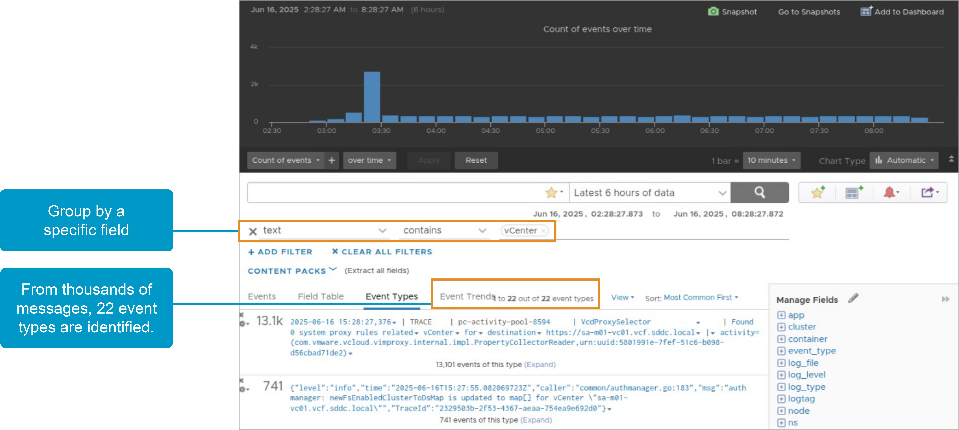
Machine Learning
VCF Operations for logs uses the machine learning technology to group similar events.
Notes:
TalkTrack:
VCF Operations for logs employs machine learning technology to group similar events. Intelligent grouping scans incoming data and quickly organizes messages by problem type, enabling high-performance searches for faster troubleshooting and root cause analysis. For instance, intelligent grouping is particularly useful when multiple virtual machines have events, and these events originate from the same host. These groupings are presented as event types. Each new type discovered by machine learning is represented by a smart field, which can be time stamps, strings, integers, and hexadecimals. Event types are also added as part of the content pack. Machine learning performs several key functions. It includes automatic event clustering. Similar events are clustered by reverse engineering the lines of code that generated those events. For example, a search that retrieved 10,000 events might be summarized as 16 unique event types. Clustering events at ingestion time provides zero impact on interactive analytics. Schema discovery is another function. The structure of the data is understood automatically. Automatic field extraction of smart fields is defined for each event, including their data types.
<End>
Intelligent grouping scans the incoming data and quickly groups messages by problem type, enabling high-performance searches for faster troubleshooting and root cause analysis.
For example, intelligent grouping is useful when the VMs have several events and they are on the same host.
These groupings display as event types. Each new type that the machine learning discovers is represented by a smart field. Types can be time stamps, strings, integers, and hexadecimals. Event types are also added as a part of the content pack.
Machine learning performs the following functions:
Automatic event clustering:
Similar events are clustered by reverse engineering the lines of code that generated events.
For example, a search that retrieved 10,000 events can be summarized as 16 unique event types.
Clustering events at ingestion time provides zero impact on the interactive analytics.
Schema discovery:
The structure of the event is understood automatically.
Automatic field extraction of smart fields is defined for each event, including their data types.

Slide 26
About Queries
Queries in VCF Operations for logs can retrieve and summarize events.
You can create and save queries on the Explore Logs page. A query includes one or more of the following pieces of information:
Keywords: Complete matches or full-text, alphanumeric, hyphen, or underscore matches
Globs: Complete matches or full-text, alphanumeric, hyphen, or underscore matches
Regular expressions: Sophisticated string pattern matching based on Java regular expressions
Field operations: Keyword, regular expression, and pattern matches applied to the extracted fields
Aggregations: Functions that are applied to one or more subgroups of the results
VCF Operations for logs supports the following types of queries:
Message: Queries that include keywords, regular expressions, or field operations
Regular expression or field: Queries that include keywords or regular expressions
Aggregation: Queries that include a function, one or more groupings, and any number of fields
Notes:
TalkTrack:
Queries in VCF Operations for logs can retrieve and summarize events. Queries can be created and saved on the Explore Logs page. A query typically consists of one or more of the following pieces of information: Keywords, which provide complete matches or full-text, alphanumeric, hyphen, or underscore matches. Globs, which give complete matches or full-text, alphanumeric, hyphen, or underscore matches. Regular expressions, which offer sophisticated string pattern matching based on Java regular expressions. Field operations, which involve keyword, regular expression, and pattern matches applied to extracted fields. Aggregations functions that are applied to one or more subgroups of the results. VCF Operations for logs supports specific types of queries: Message queries, consisting of keywords, regular expressions, or field operations. Regular expression or field queries, consisting of keywords or regular expressions. Aggregation, which involves queries consisting of a function, one or more groupings, and any number of fields. In single-row filters, comma-separated values can be used to list OR filters. For example, if a search specifies "Hostname contains 127.0.0.1, 127.0.0.2", the search returns events with host names 127.0.0.1 or 127.0.0.2. The text contains a filter that considers each comma-separated value as a complete keyword. Globs can be used in search terms, for example, vm* or view*e. The ? symbol represents a single character, while the * symbol represents zero or more characters. Globs cannot be used as the first character of a search term. For example, one can enter 192.168.0.*, but not *.168.0.* in the filtering queries. Custom alerts can be defined in VCF Operations for logs, triggering from scheduled queries of any type. For further information on queries in VCF Operations for logs, refer to the documentation at docs.vmware.com.
<End>
In a single-row filter, you can use comma-separated values to list OR filters. For example, if you select Hostname contains and enter 127.0.0.1, 127.0.0.2 in the search box, the search returns events with the host name 127.0.0.1 or 127.0.0.2. The text contains a filter that considers each comma-separated value as a complete keyword.
You can use globs in search terms, for example, vm* or vmw?re. You use * for zero or more characters, whereas you use ? for a single character. Globs cannot be used as the first character of a search term. For example, you can enter 192.168.0.*, but you cannot use *.168.0.0 in your filtering queries.
You can define custom alerts in VCF Operations for Logs and trigger them from scheduled queries of any type.
For information, see the section about queries in Using VCF Operations for logs at https://techdocs.broadcom.com/us/en/vmware-cis/vcf/vcf-9-0-and-later/9-0/infrastructure-operations/log-analysis/the-analyze-page.html.

Slide 27
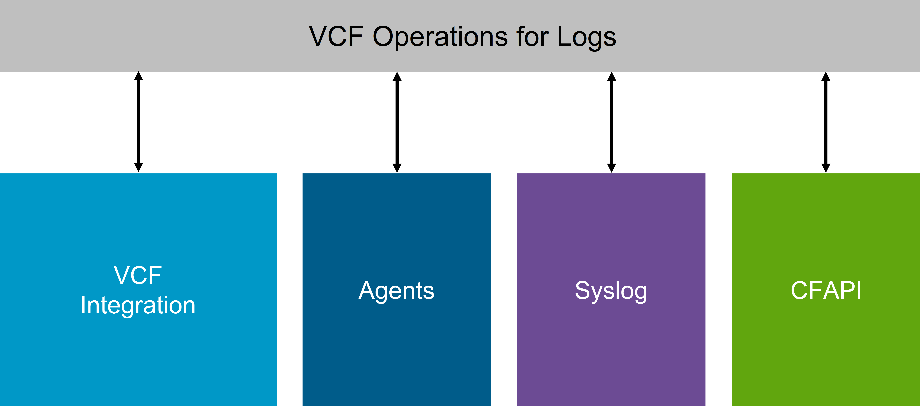
Log Event Details
You can connect VCF Operations for logs to everything in your environment, including operating systems, applications, storage, firewalls, and network devices, for enterprise-wide visibility using log analytics.
Notes:
TalkTrack:
VCF Operations for logs connects to everything in the environment, including operating systems, applications, firewalls, and network devices, to provide enterprise-wide visibility through log analytics. When VCF Operations for logs is configured and ready to collect logs, it can ingest log data in several ways. One method is through vSphere integration. VCF Operations for logs can integrate with vSphere to automatically ingest events from a vCenter Server and logs from ESX hosts. Another way is through VCF Operations integration. VCF Operations for logs can integrate with VCF Operations to enable various alerts to send notification events to VMware Aria Operations and emails to administrators. Agents are also a method of collection. VCF Operations for logs has collection agents available to send files and event logs from Linux or Windows to VCF Operations for logs. Syslog is another ingestion method. VCF Operations for logs can ingest data from any source through Syslog. The VCF Operations for logs server simply needs to be set as the Syslog destination. Finally, CFAPI events can be sent. CFAPI events are sent in their original format to VCF Operations for logs using the Collection Framework API, CFAPI protocol. Events sent over CFAPI do not have to follow the guidelines of a Syslog event, and are not modified to comply with the Syslog RFC.
<End>
When VCF Operations for logs is configured and ready to collect logs, you can ingest log data in several ways:
vSphere integration: VCF Operations for logs can integrate with vSphere to automatically ingest events from a vCenter server and logs from ESX hosts.
VCF Operations integration: VCF Operations for logs can integrate with VCF Operations to enable various alerts to send notification events in VMware Aria Operations and emails to administrators.
Agents: VCF Operations for logs has collection agents available to send files and event logs from Linux or Windows to VCF Operations for logs.
Syslog: VCF Operations for logs can ingest data from any source through Syslog. Just set the VCF Operations for logs server as your Syslog destination.
CFAPI: Events are sent in their original format to VCF Operations for logs using the Collection Framework API (CFAPI) protocol. Events sent over CFAPI do not have to follow the guidelines of a Syslog event, and they are not modified to comply with the Syslog RFC.

Slide 28
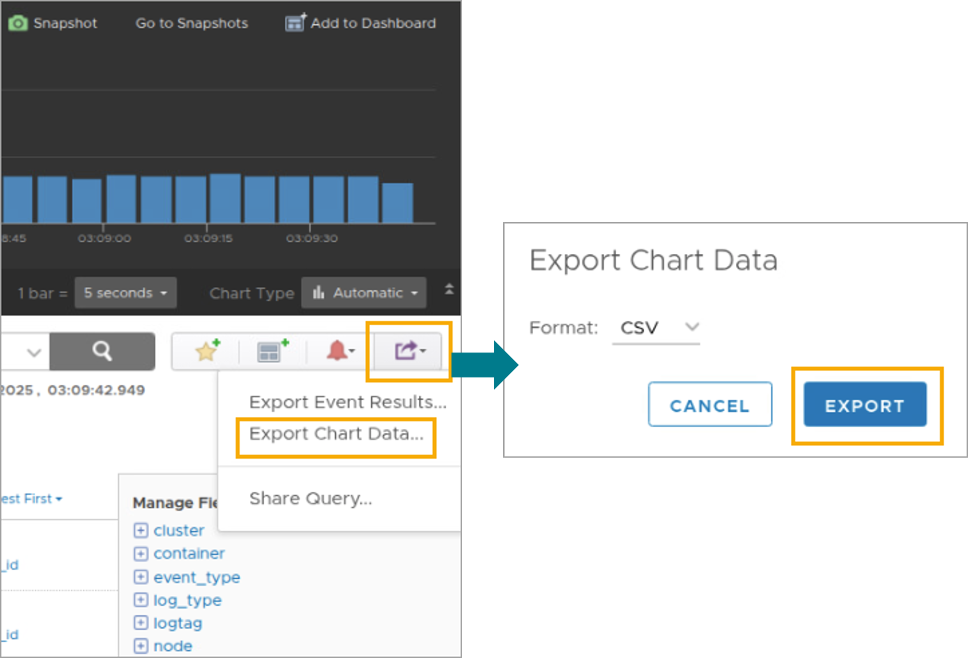
Exporting Data
You can export data from a chart to CSV and JSON formats.
Notes:
TalkTrack:
Data can be exported from a chart to CSV and JSON formats. Often, data from a chart is needed for another purpose or must be archived. VCF Operations for logs enables chart data to be exported as CSV or JSON data. By exporting data, VCF Operations for logs can be used in reports and other dashboards. Using JSON, data can be transferred to other cloud management tools.
<End>
Often, the data from a chart is needed for another purpose or must be archived. VCF Operations for logs enables the chart data to be exported as CSV or JSON data.
By exporting data, you can use VCF Operations for logs in your reports and other dashboards. Using JSON, you can transfer the data to the other cloud management tools.

Slide 29
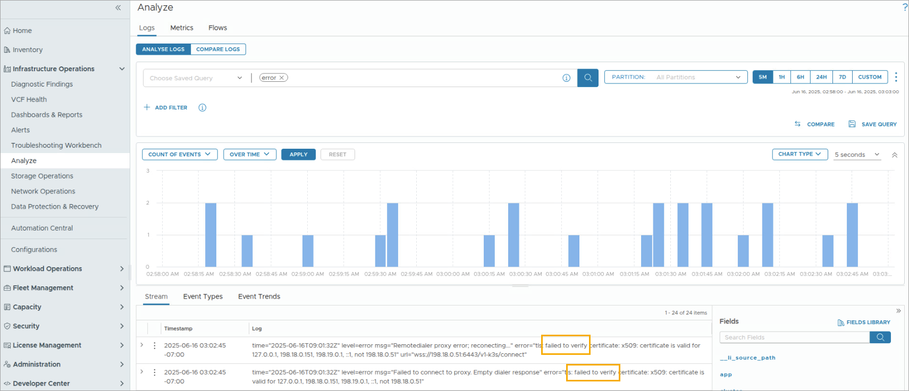
Example: Filter on Error
A common query is to search for error in the collected log files.
Notes:
TalkTrack:
A common query involves searching for "error" within collected log files. By searching for a common indicator of problems, problems that require addressing can be identified. In the screenshot, events are filtered using the "error" keyword. The blue bar in the overview chart indicates the number of events that occurred during the selected time range.
<End>
By searching for a common indicator of problems, you can identify problems that must be addressed. In the screenshot, events are filtered using the "error" keyword. The blue bar in the overview chart indicates the numbers of the events that occurred during the selected time range.

Slide 30
Lab: VCF Operations for Logs Appliance
Check the operations-logs status and configure the log collection settings for VCF Operations:
Examine the VCF Operations for Logs Appliance
Set Up Log Collection for VCF Operations
Create Log Events
Review and Analyze Logs with Simple Queries

Slide 31
Review of Learner Objectives
Describe the VCF Operations for logs overview
Describe the requirements for a log analytics solution
Describe the key benefits of VCF Operations for logs overview
Access the VCF Operations for logs UI

Slide 32
VCF Storage Operations

Slide 33
Learner Objectives
Describe the VCF Storage Operations overview
Identify performance and health issues with the Storage clusters
Recognize the benchmarking and optimization tool to detect issues for a new cluster

Slide 34
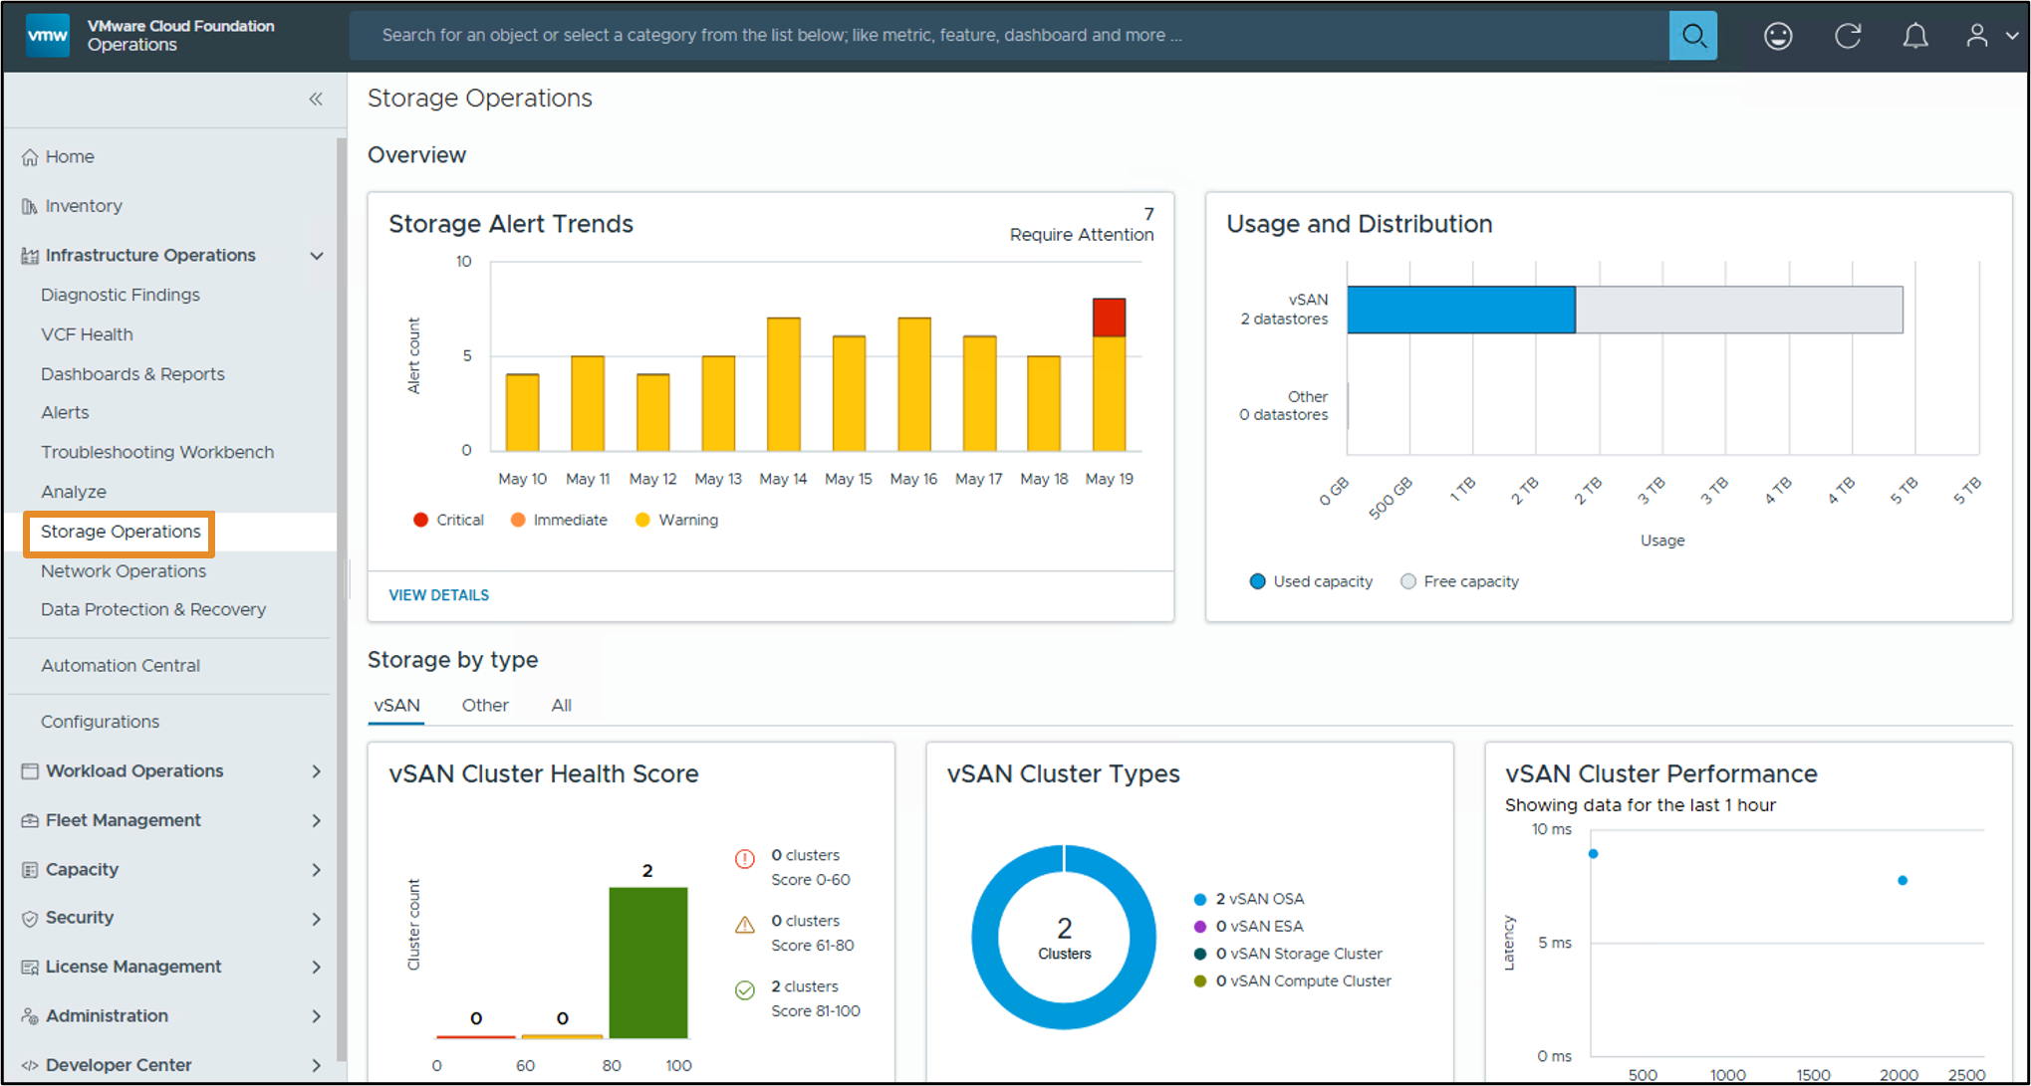
About Storage Operations
The Storage Operations page is a centralized storage dashboard for vSAN and other storage options in VCF Operations.
Notes:
TalkTrack:
The Storage Operations page provides a centralized storage dashboard for vSAN and non-vSAN storage options in VCF Operations. Storage operations are a common place in the VCF Ops Console where users can find detailed aggregated information about storage being part of their virtual infrastructure. It allows users to easily spot performance or health problems with the clusters, and then drill down and further troubleshoot the problems. The storage operations page can be used to view storage-related alerts and to view the usage and distribution of vSAN and non-vSAN datastores for a more detailed overview. Filters can be applied for vSAN and non-vSAN datastores. The vSAN cluster health score and the different types of vSAN clusters available in VCF Operations can be viewed. Additionally, clicking on any cluster dot allows viewing basic performance metrics like IOPS, Latency, and Throughput for that particular vSAN cluster. The storage operations page also displays vSAN cluster run time configurations, such as vSAN cluster type like ESA or OSA, and capacity usage, with space efficiency presented in a tabular format. Additional information on Storage Operations functionality can be found in the provided documentation.
<End>
Storage operations is a common place in the VCF Ops Console UI where users can find detailed aggregated information about the storage being part of their virtual infrastructure. It allows users to easily spot performance or health problems with the clusters, then drill-down and further troubleshoot the problems. Use the storage operations page to view storage related alerts and view the usage and distribution of your vSAN and non-vSAN datastores. You can filter vSAN and non-vSAN datastores for a more detailed overview. You can view the vSAN cluster health score and the different types of vSAN clusters available in VCF Operations. Additionally you can click on any cluster dot to view the basic performance metrics like IOPS, Latency, and Throughput for that particular vSAN cluster. The storage operations page also displays vSAN cluster run-time configuration, vSAN cluster type like ESA or OSA, capacity usage, space efficiency in a tabular format.

Slide 35
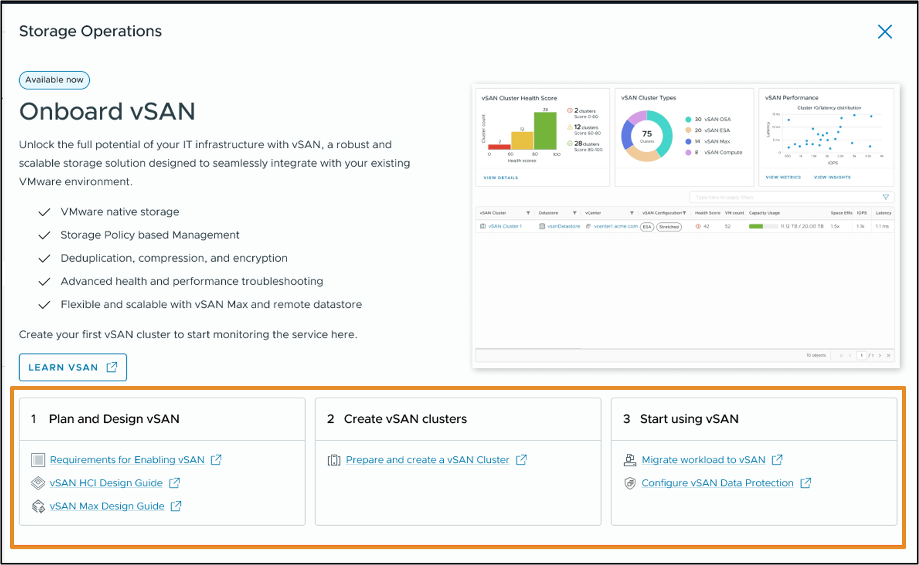
About the Onboard vSAN Page
The Onboard vSAN page provides information about vSAN planning and deployment and describes how to design and deploy a vSAN cluster.
Notes:
TalkTrack:
The Onboard vSAN page provides information on vSAN planning and deployment and describes how to design and deploy a vSAN cluster. To plan and build a vSAN cluster for a production environment, especially if vSAN is new to an organization, the onboarding vSAN page provides documentation links for planning, designing, and creating a vSAN cluster.
<End>
To plan and build a vSAN cluster for your production environment, if you are new to vSAN. The onboarding vSan page provides documentation links to plan design and create a vsan cluster

Slide 36
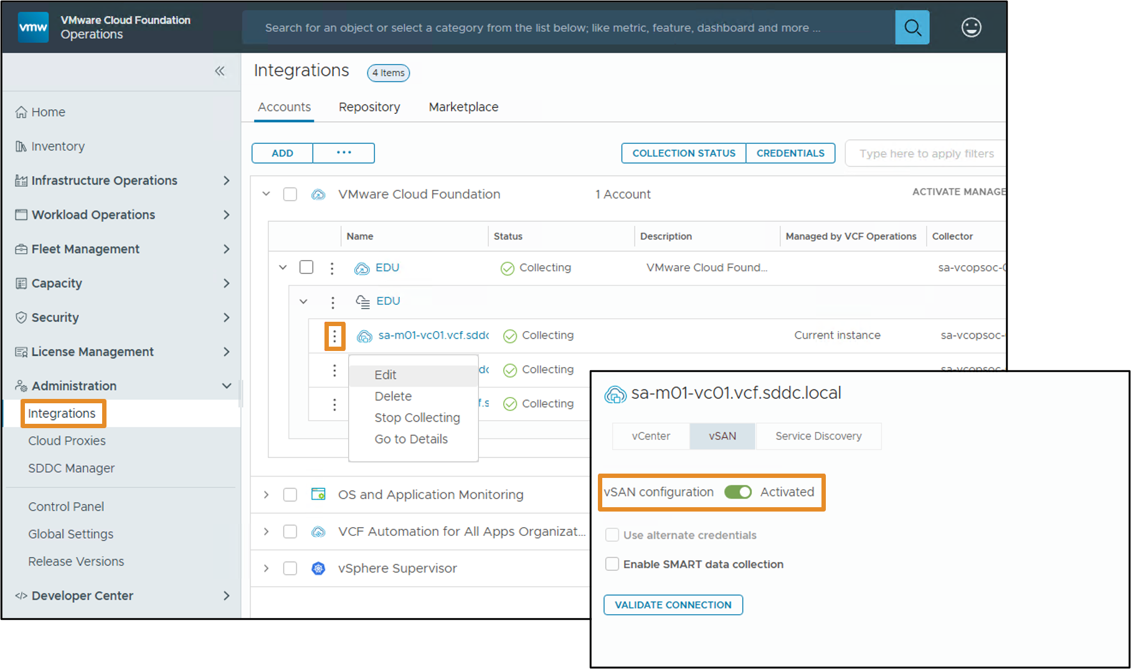
Configuring a vCenter Cloud Account
To view data related to vSAN on the storage operations page, you must configure a vCenter account that is enabled by vSAN.
Notes:
TalkTrack:
To view vSAN related data on the storage operations page, a vSAN enabled vCenter account must be configured. The vCenter instance also needs to be collecting data in VCF Operations. The vCenter and vSAN integrations are pre-installed and cannot be deactivated. Once the vSAN adapter instance is activated and saved, the activated vSAN configuration option becomes visible. The vSAN account begins collecting data. The newly connected vSAN account information appears on all vSAN dashboards after five minutes. An overview of vSAN health and performance is available on the Storage Operations page. More information on monitoring Storage Operations is available in the VMware Aria Operations guide. To view vSAN performance for each cluster individually and to drill down into specific performance criteria, the vSAN Performance dashboard should be used.
<End>
To view vSAN related data on the storage operations page, you must configure a vSAN enabled vCenter account and ensure that the vCenter instance is collecting data in VCF Operations. The vCenter and vSAN integrations that are pre-installed and cannot be deactivated.
Once the vSAN adapter instance is activated and saved, the activated vSAN configuration option is not visible.
The vSAN account starts collecting data. The newly connected vSAN account information will appear on all vSAN dashboards after five minutes. You can get an overview of the vSAN health and performance in the Storage Operations page. For more information see the Monitoring Storage Operations topic in the Using VMware Aria Operations guide. To view vSAN performance for each cluster individually and to drill down info specific performance criteria, use the vSAN Performance dashboard.

Slide 37
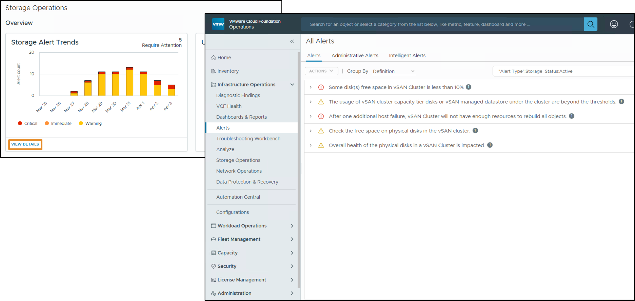
Storage Alert Trends Widget
The widget shows a chart with historical data about the storage alerts in the past 10 days.
Notes:
TalkTrack:
The widget displays a chart with historical data about storage alerts from the past 10 days. The widget shows "No data found", a default "Core" component when no alerts are returned. A default error component appears if the backend call encounters an error. At the footer of the widget, there is a link to the Alerts screen where a "storage" type filter is preselected.
<End>
The Widget shows No data Found default Core component when no alerts have been returned and default Error component when the backend call throws an error. At the footer of the Widget we have a link to the Alerts screen where we preselect "storage" type filter.

Slide 38
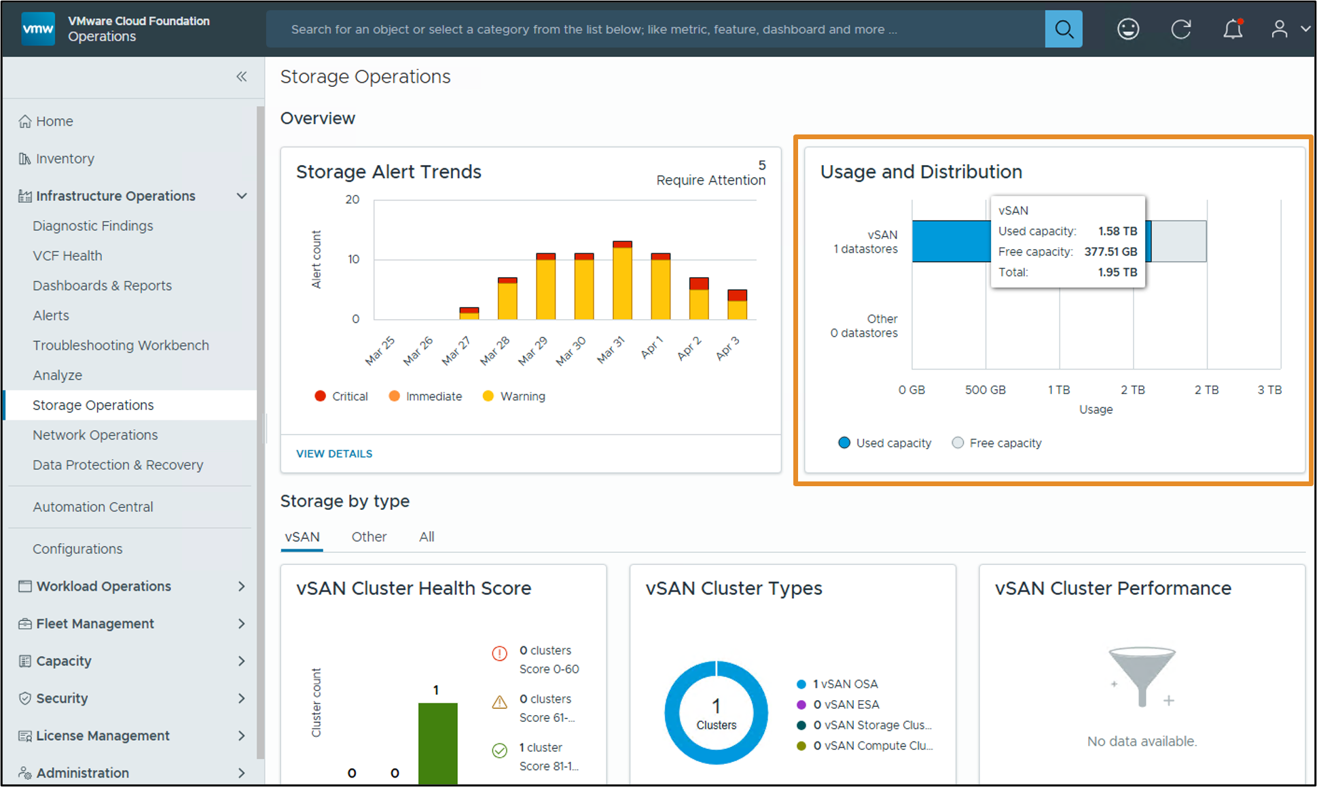
Usage and Distribution Widget
The Usage and Distribution widget shows the storage distribution and its utilization by type: vSAN and other data stores.
Notes:
TalkTrack:
The Usage and Distribution Widget displays the storage distribution and its utilization by type, specifically for vSAN and non-vSAN storage. The bar chart represents an aggregation of all capacity available by a given datastore type and its usage. In front of the bar chart, a label indicates the storage type and the number of datastores contributing usage.
<End>
The bar chart represents an aggregation of all capacity available by a given datastore type and its usage. In front of the bar chart we show label indicating the storage type and the number of datastores contributing storage

Slide 39
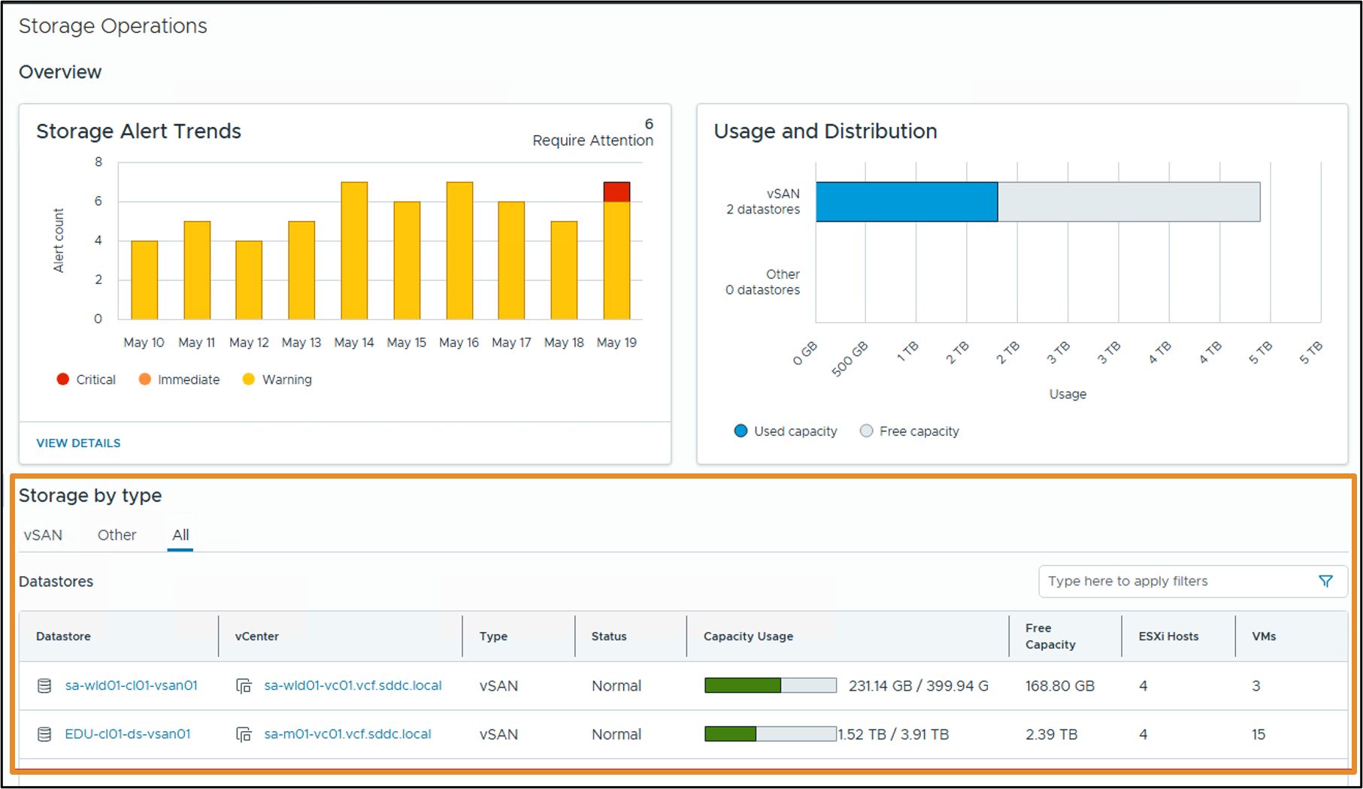
Storage by Type Widget
The Storage by Type widget shows three tabs: vSAN, Other, and All. When selected, each tab shows information about the selected data store type.
Notes:
TalkTrack:
The Storage by Type widget presents information in three tabs: vSAN, Non-vSAN, and All. Each selected tab shows information about the corresponding datastore type. When the All tab is selected, a data grid listing all vSAN datastore clusters and their details is displayed. The data grid is always shown regardless of the datastore type being selected. It lists all data grids matching the selected tab filter. Based on the tab selection, either vSAN or other specific columns are shown.
<End>
When All is selected data grid listing all the vSAN datastores clusters and details about them is displayed.
The data grid is always shown no matter what datastore type is being selected. It lists all the data grids matching the selected tab filter. Based on the tab selection vSAN or Others different columns are shown.

Slide 40
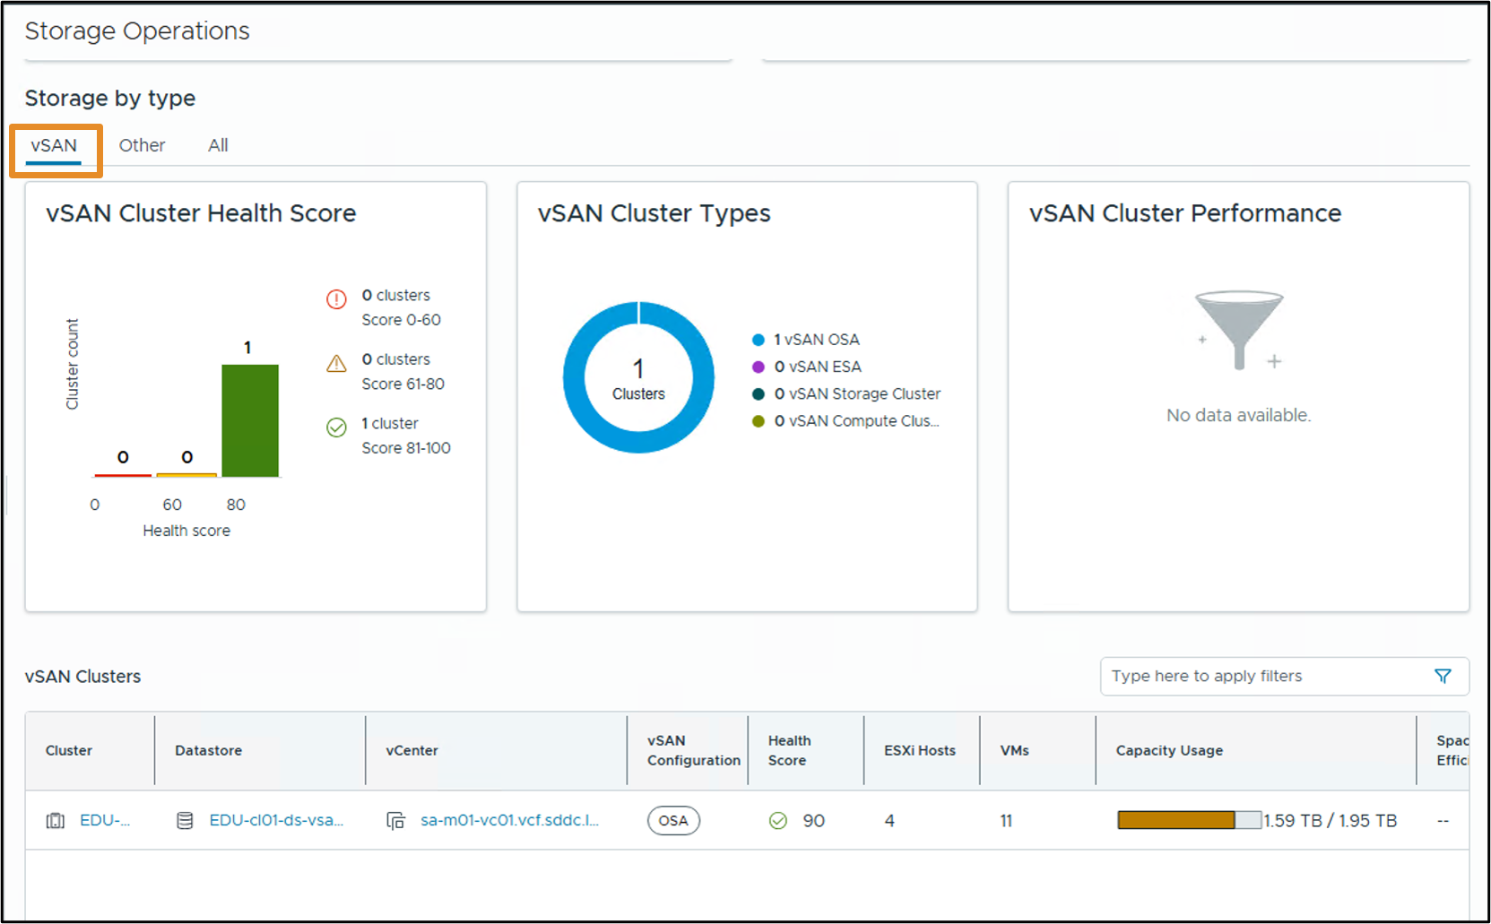
vSAN Inventory Widget
When the vSAN tab is selected, three widgets related to vSAN appear.
Notes:
TalkTrack:
When the vSAN tab is selected, three widgets related to vSAN are displayed. These include the vSAN Cluster Health Score, vSAN Cluster Types, and vSAN Cluster Performance. A data grid listing all vSAN datastores clusters and details about them is also displayed. The vSAN Cluster Health Score widget displays all vSAN clusters grouped by their health score. This widget shows three bars for every health score and includes a legend with more details. The vSAN Cluster Types widget displays a donut chart representing the distribution of the different vSAN flavors by cluster. The vSAN Cluster Performance widget displays the performance of the vSAN cluster performance statistics, including IOPS and latency. Further information on viewing diagnostics and view metrics on the vSAN cluster performance widget is available in the documentation.
<End>
When the vSAN tab is selected three Widgets related to vSAN like the vSAN Cluster Health Score, vSAN Cluster Types, vSAN Cluster Performance and a data grid listing all the vSAN datastores clusters and details about them is displayed.
vSAN Cluster Health Score Widget displays all the vSAN clusters grouped by their health score. The Widget shows 3 bars for every health score "color" and on the right we have a legend with more details.
vSAN Cluster Types Widget displays a donut chart representing the distribution of the different vSAN flavors by cluster.
vSAN Cluster Performance Widget displays the performance of the vSan cluster performance statistics, including IOPS, and latency.

Slide 41
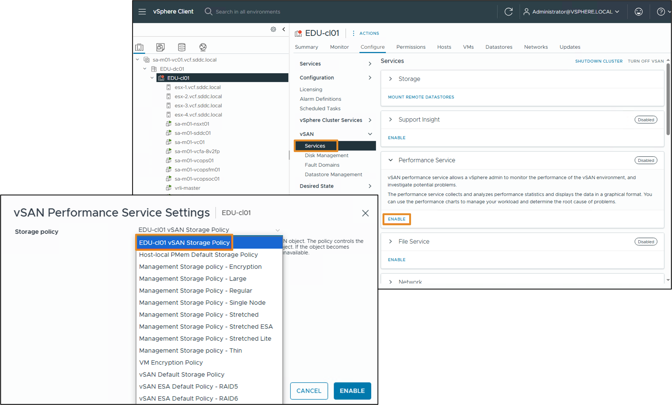
Configuring the vSAN Performance Service
If the vSAN Performance charts are empty, enable and configure the vSAN Performance Service in vCenter.
Notes:
TalkTrack:
If vSAN Performance Charts show no data, activate and set up the vSAN Performance Service within vCenter. For the Performance Service to function, vSAN utilizes a Stats database object for gathering statistical data. This Stats database is a namespace object residing on the cluster’s vSAN datastore. The historical performance data for vSAN is stored as a vSAN object. The object's policy governs its availability, space usage, and performance. If this object becomes unavailable, the cluster's performance history also becomes inaccessible. The vSAN Performance Service monitors the performance metrics for vSAN clusters, their hosts, associated disks, and virtual machines.
<End>
To support the Performance Service, vSAN uses a Stats database object to collect statistical data. The Stats database is a namespace object in the cluster's vSAN datastore.
The vSAN performance history database is stored as a vSAN object. The policy controls the availability, space consumption, and performance of that object. If the object becomes unavailable, the performance history for the cluster is also unavailable.
vSAN Performance Service to monitor the performance of vSAN clusters, hosts, disks, and VMs
vSAN Cluster Types Widget displays a donut chart representing the distribution of the different vSAN flavors by cluster.
vSAN Cluster Performance Widget displays the performance of the vSan cluster performance statistics, including IOPS, and latency.

Slide 42
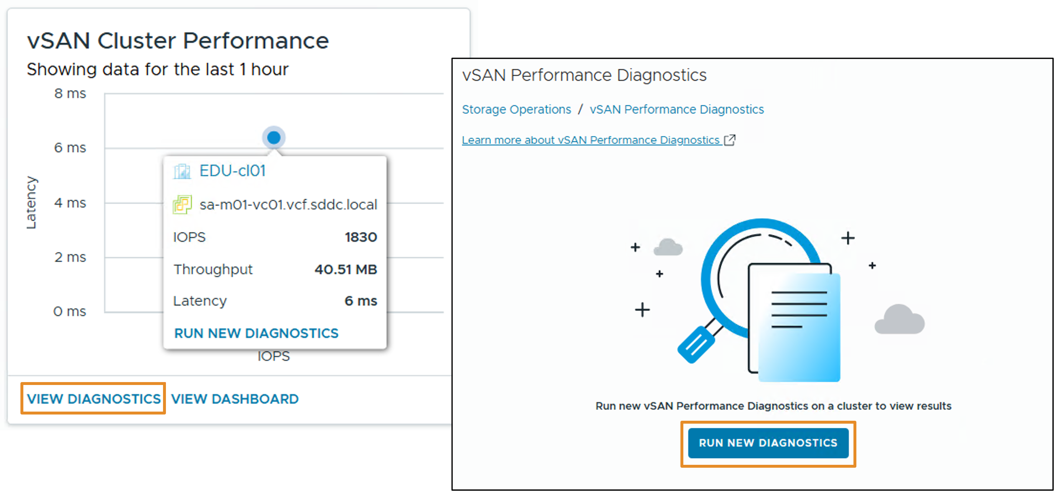
Performance Diagnostics
The vSAN cluster performance tile provides an overview of the performance of the vSAN clusters in relation to one another.
Notes:
TalkTrack:
The vSAN cluster performance view offers an overview of how vSAN clusters are performing in relation to one another. The performance diagnostics of all vSAN clusters can be accessed. Run diagnostics can also be initiated from this view.
<End>
You can view the performance diagnostics of all the vSAN clusters and run performance diagnostics from View Diagnostics or Run New Diagnostics.
You can view the performance diagnostics of all the vSAN clusters and run performance diagnostics from View Diagnostics and click Run New Diagnostics.

Slide 43
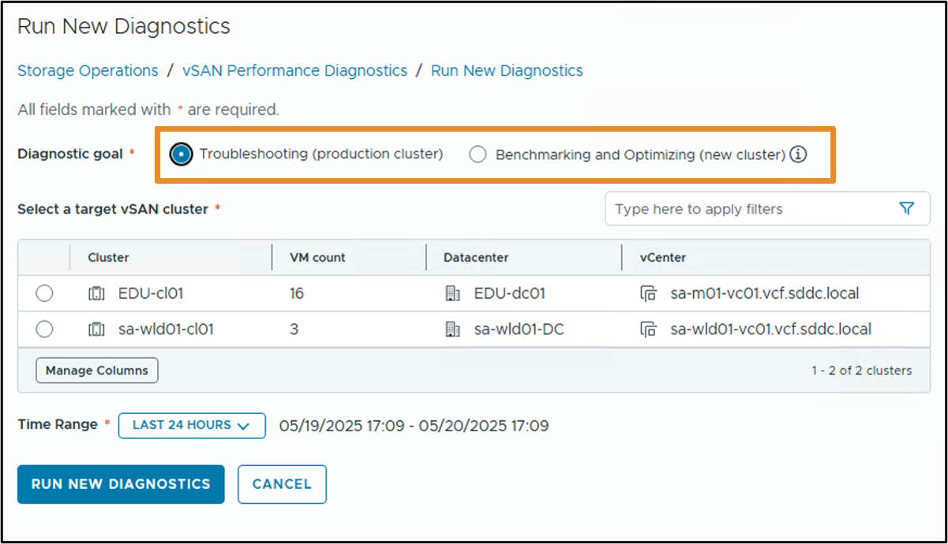
Running Performance Diagnostics
The Performance Diagnostics screen enables the user to analyze and troubleshoot potential performance issues and anomalies.
Notes:
TalkTrack:
The performance diagnostics screen allows users to analyze and troubleshoot potential performance issues and anomalies. For troubleshooting, performance diagnostics can be run for a cluster already in use with a workload. This helps identify performance issues impacting the workload and aids in troubleshooting. For benchmarking and optimizing, performance diagnostics can be executed for a new cluster before adding any workload. This allows running diagnostics with a specific benchmark goal.
<End>
The Performance Diagnostics screen will provide the user the functionality to analyze and troubleshoot potential performance issues and anomalies
Troubleshooting: Run performance diagnostics for a cluster that is already in use and has a workload running on the cluster. This enables you to identify if there are performance issues that impact the workload and troubleshoot them.
Benchmarking and Optimizing: Run performance diagnostics for a new cluster before adding any workload. This enables you to run diagnostics with a Benchmark goal.

Slide 44
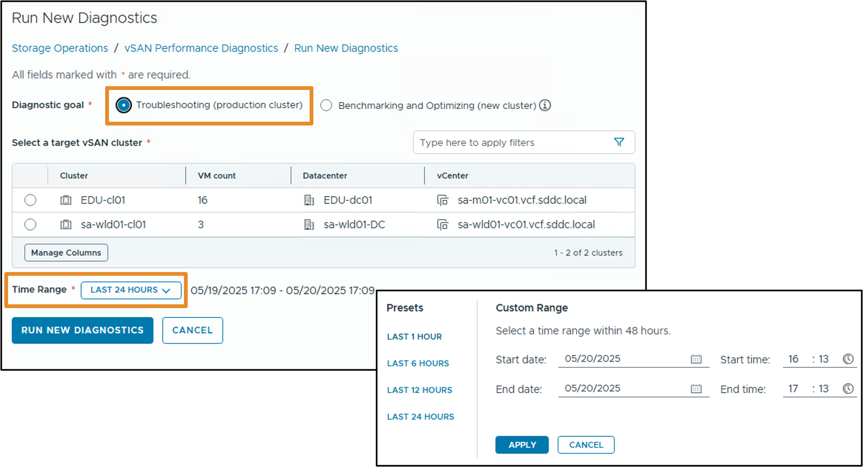
Troubleshooting a Production Cluster
Run performance diagnostics for a cluster that is already in use and has a workload running on the cluster.
Notes:
TalkTrack:
Performance diagnostics can be run for a cluster already in use with a workload. This assists in identifying performance issues affecting the workload and helps with troubleshooting. After diagnostics are run, the vSAN Performance Diagnostics page appears. It displays cluster information, diagnostic results, and recommended remediation steps. Performance diagnostics reports historical data going back up to seven days. Diagnostics can be re-run or a new diagnostic scan can be initiated.
<End>
After you Run New Diagnostics, the vSAN Performance Diagnostics page appears. It displays the cluster information, diagnostics results, and the remediation steps and suggestions. The Performance Diagnostics report dates back to seven days only. You can Rerun the diagnostics or run a new diagnostic scan.

Slide 45
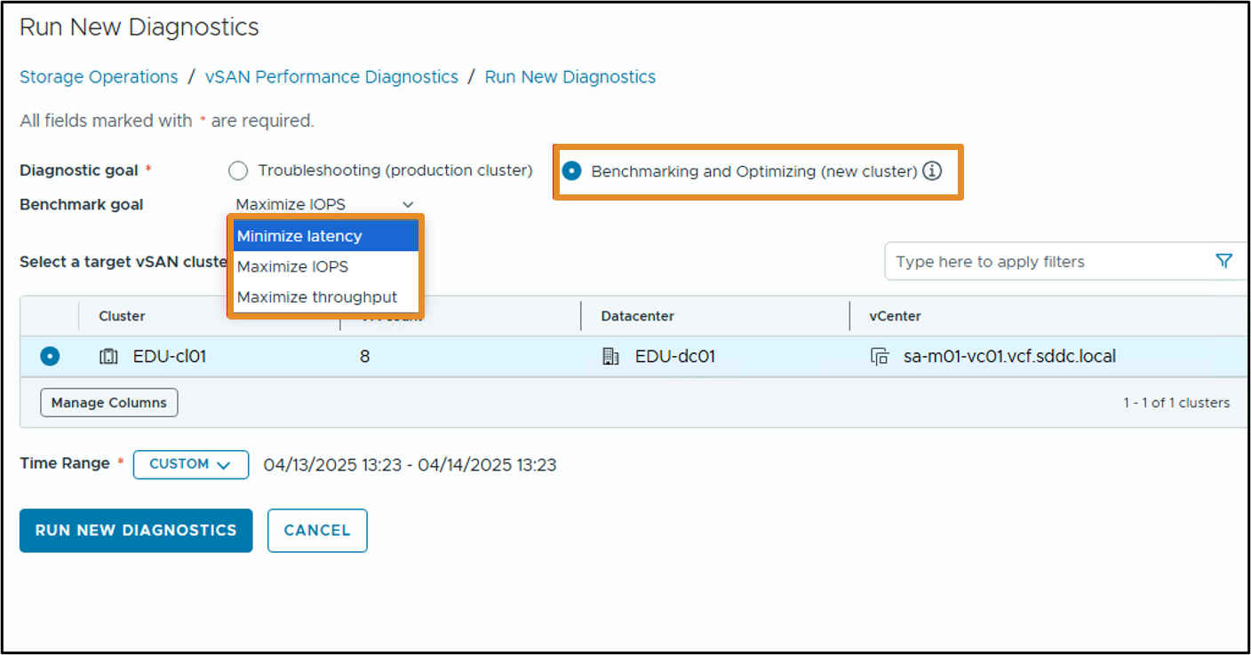
Benchmarking and Optimizing
To run benchmarking and optimization for a new cluster, before adding any workload, select a Diagnostic goal and select the target vSAN cluster.
Notes:
TalkTrack:
For benchmarking and optimization purposes, a new cluster can undergo performance diagnostics before any workload is added. A diagnostic goal needs to be selected for the vSAN cluster. The vSAN performance diagnostics analyzes previously run benchmarks, gathered from the vSAN performance service. It identifies issues, suggests remediation steps, and provides supporting performance graphs for further insights. A specific goal can be chosen for the desired performance improvement. Examples include maximizing IOPS, maximizing throughput, or minimizing latency.
<End>
The vSAN performance diagnostics analyzes previously run benchmarks gathered from the vSAN performance service. It can detect issues, suggest remediation steps, and provide supporting performance graphs for further insight.
You can select a goal based on the performance improvement that you want to achieve, such as maximum IOPS, maximum throughput, or minimum latency.

Slide 46
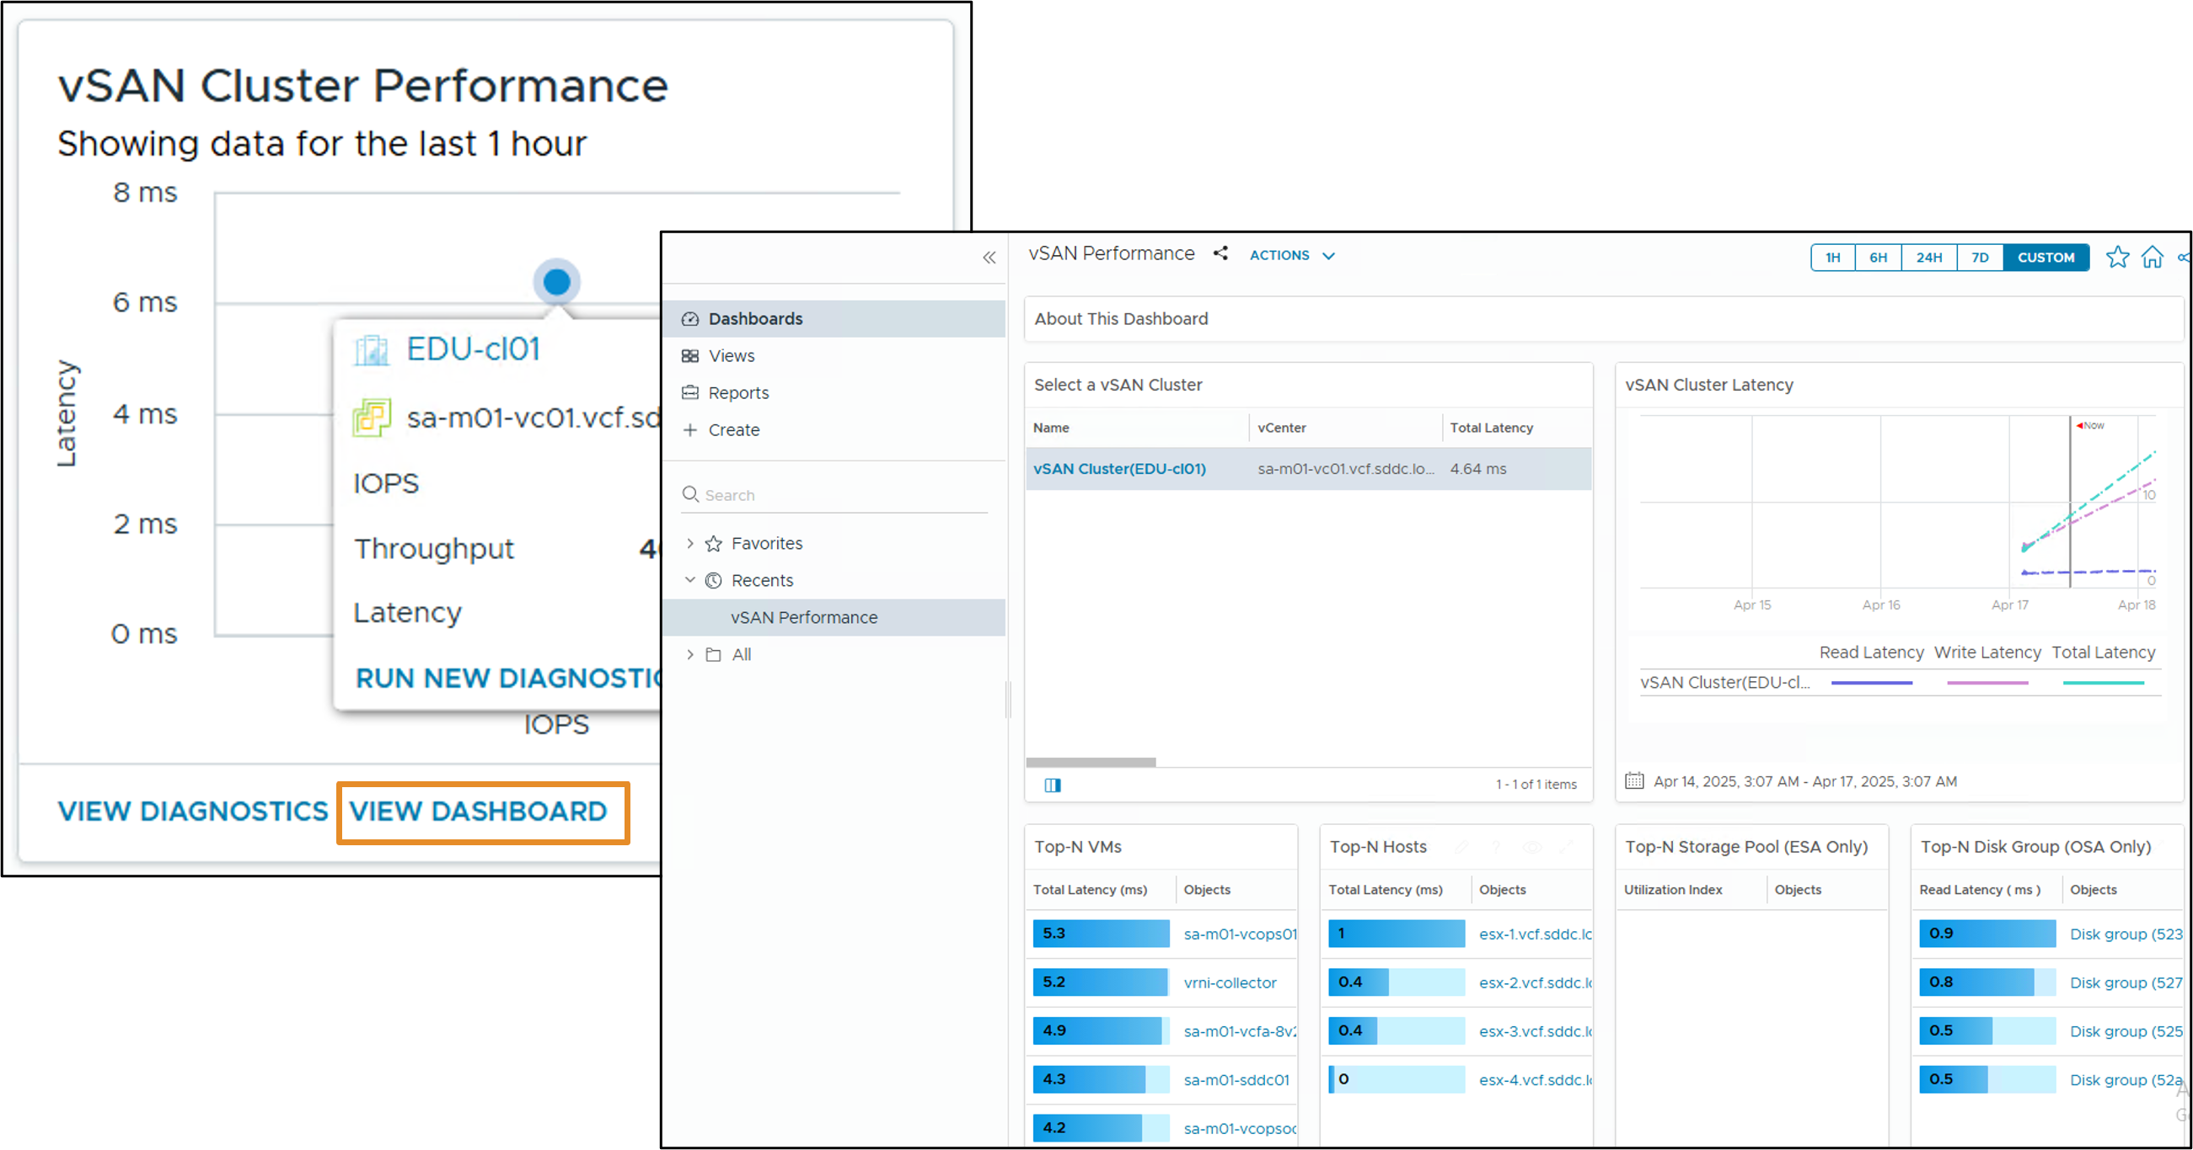
vSAN Performance Dashboard
You can use the vSAN cluster performance charts to monitor the workload in your cluster and determine the root cause of problems.
Notes:
TalkTrack:
vSAN cluster performance charts allow for workload monitoring within the cluster and root cause identification for problems. The cluster summary provides an overview of vSAN performance statistics, including vSAN IOPS, throughput, and latency. At the cluster level, detailed statistical charts for virtual machine consumption and the vSAN back end are available.
<End>
The cluster summary displays an overview of vSAN performance statistics, including vSAN IOPS, throughput, and latency. At the cluster level, you can view detailed statistical charts for virtual machine consumption and the vSAN back end.

Slide 47
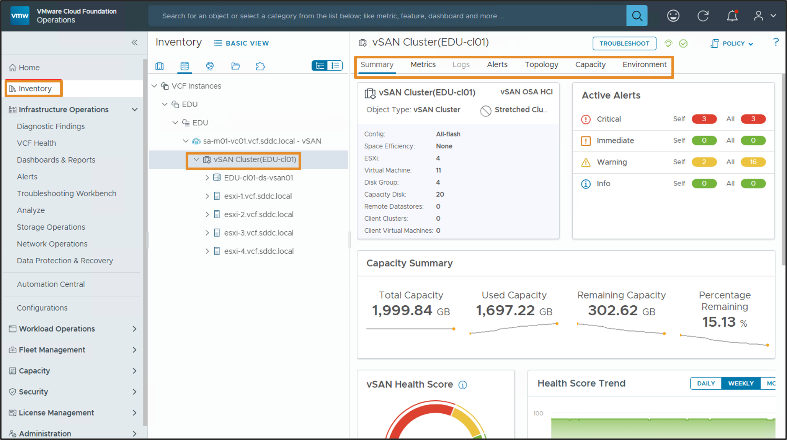
VCF Operations Inventory
You can manage and monitor the health and performance of your vSAN clusters and remediate alerts in VCF Operations.
Notes:
TalkTrack:
Health and performance of vSAN clusters can be managed and monitored within VCF Operations. Alerts can also be remediated. The inventory section allows for viewing cluster summaries, metrics, logs, alerts, capacity information, and the environment details. Key performance indicators, such as total, used, and remaining capacity, are displayed. A health score for vSAN and trends over daily or weekly periods are also visible.
<End>

Slide 48
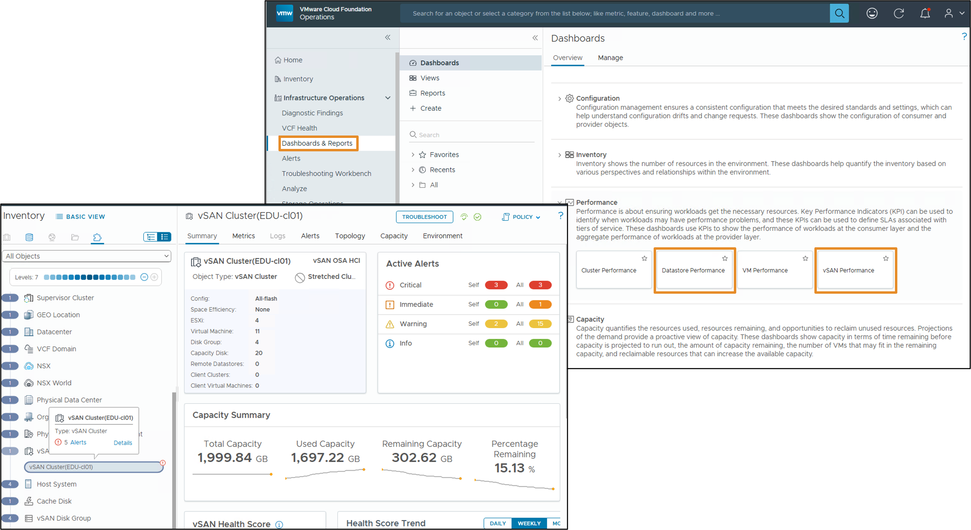
Storage Performance Dashboards
The Datastore and vSAN Performance dashboard helps identify storage-related performance issues such as high latency, high outstanding I/O, and low utilization.
Notes:
TalkTrack:
The Datastore and vSAN Performance dashboard assists in identifying storage-related performance issues. These issues can include high latency, significant outstanding I/O, or low utilization. The Storage Performance dashboard is designed for both the VMware administrator and the storage administrator, fostering a close collaboration between the two teams. Local datastores are treated separately.
<End>
Use the Datastore Performance dashboard to view performance problems related to storage such as high latency, high outstanding IO, and low utilization. This dashboard is designed for both the VMware administrator and the Storage administrator, to foster a closer collaboration between the two teams. Local datastores are treated separately.

Slide 49
Lab: Monitoring Storage Operations
Practice storage monitoring in the VCF Operations console:
Review the vSAN Cluster Details in VCF Operations
Monitor Storage Operations in VCF Operations

Slide 50
Review of Learner Objectives
Describe the VCF Storage Operations overview
Identify performance and health issues with the Storage clusters
Recognize the benchmarking and optimization tool to detect issues for a new cluster

Slide 51
VCF Network Operations

Slide 52
Learner Objectives
Describe the VCF Network Operations overview
Discuss the different widgets available in VCF Network Operations
Identify performance and health issues with the VCF Networking objects

Slide 53
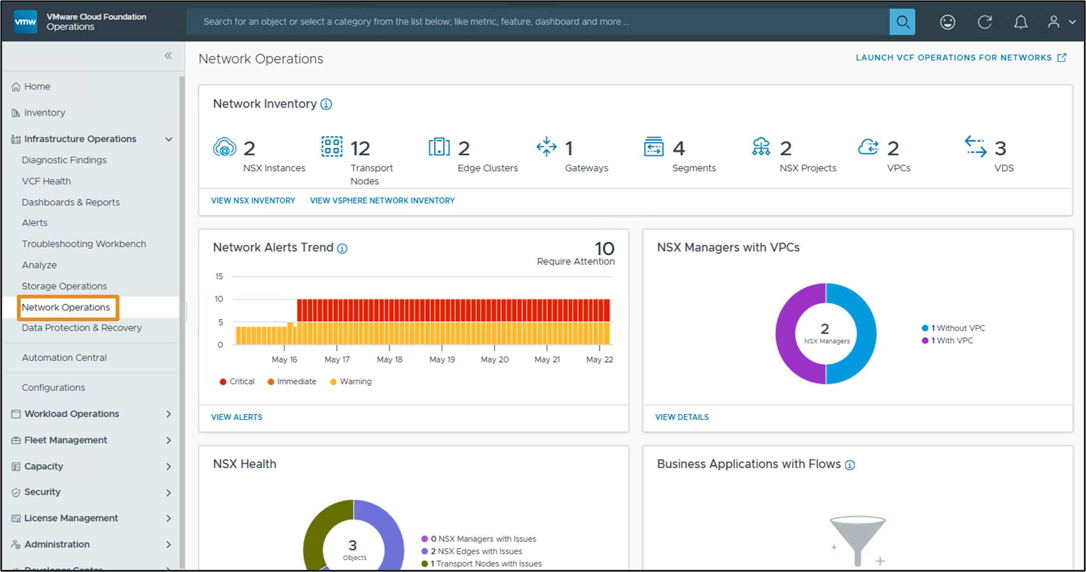
About VCF Operations for Networks
Network Operations provides you with an overview of your VCF Operations network resources and quick access to the VCF Operations for networks console.
Notes:
TalkTrack:
Network Operations provides an overview of VCF Operations network resources. It also offers quick access to the VCF Operations for networks console. VCF Operations for Networks delivers intelligent operations for software defined networking and security. It helps customers build an optimized, highly available, and secure network infrastructure across multi cloud environments. VCF Operations for Networks accelerates micro segmentation planning and deployment. It enables visibility across virtual and physical networks. Operational views to manage and scale VMware NSX deployments are also provided. The Network Operations page includes several useful widgets that provide information on deployment network status and resources.
<End>
VCF Operations for networks delivers intelligent operations for software-defined networking and security. It helps customers build an optimized, highly-available, and secure network infrastructure across multi-cloud environments.
VCF Operations for networks accelerates micro-segmentation planning and deployment, enables visibility across virtual and physical networks, and provides operational views to manage and scale the VMware NSX deployments.
The Network Operations page includes several useful widgets that provide information on your deployments networking status and resources.

Slide 54
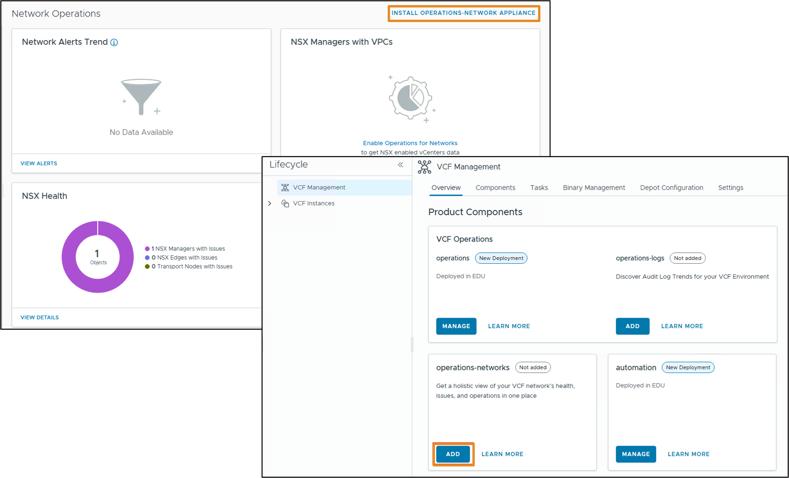
Operations for Networks Prerequisites
To view network details events in VCF Network Operations, deploy the VCF Operations for networks appliance.
Notes:
TalkTrack:
To view network details in VCF Operations, the VCF Operations for networks appliance must be deployed. The VCF Operations for networks adapter activates the integration between VCF Operations and VCF Operations for networks. VCF Operations for networks receives problem events from VCF Operations for networks. It then publishes these alerts in VCF Operations. Alerts are mapped correctly to the common objects between VCF Operations for networks and VCF Operations. Common objects supported in this adapter include vCenter Server, VMware NSX-T, and VMware NSX for vSphere. For these common objects, VCF Operations supports launching in context to VCF Operations for networks. This allows for deep network troubleshooting within the VCF Operations for networks environment. The information displayed on the Network Operations page is limited to inventory, alerts, and NSX health data. If the VCF Operations for networks appliance has not been deployed, installing the Operations Network Appliance is necessary to view this information.
<End>
The VCF Operations for networks adapter activates integration of VCF Operations with VCF Operations for networks.
The VCF Operations for networks adapter gets problem events from VCF Operations for networks and publishes the alerts in VCF Operations. Alerts are mapped correctly to the common objects between VCF Operations for networks and VCF Operations. Common objects supported in this adapter are vCenter Server, VMware NSX-T, and VMware NSX for vSphere. For the common objects, VCF Operations supports launch-in-context to VCF Operations for networks. This allows the user to perform deep network troubleshooting with the VCF Operations for networks.
The scope of information provided on the Network Operations is limited to inventory, alert, and NSX health information if you have not deployed the VCF Operations for networks appliance. To deploy the appliance, click Install Operations Network Appliance on the top right of the Network Operations page.

Slide 55
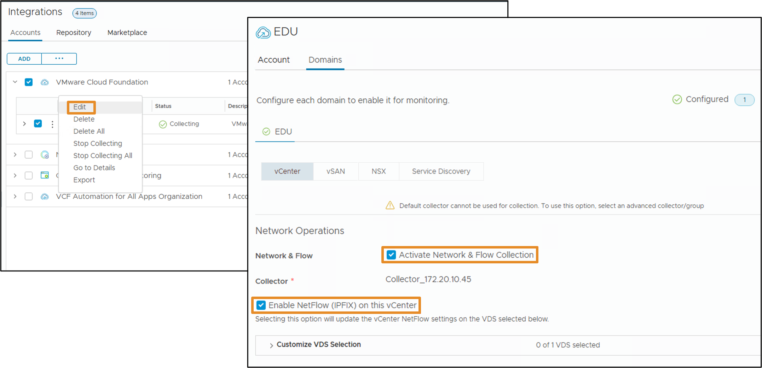
Turning on Flow Collection for vCenter and NSX
To enable data sync between the vCenter data source and VCF Operations for networks, select the data source and activate network and flow collection.
Notes:
TalkTrack:
To enable data synchronization between VMware vCenter data sources and VCF Operations for networks, select the data source, activate network and flow collection. VMware vCenter data sources can be added directly from VCI Operations by navigating to integrations. To enable data synchronization, select the data source and activate network and flow collection. NetFlow IPFIX collection can also be enabled on this vCenter option. In a vSphere environment, NetFlow can be configured to export flow information using IPFIX. Monitoring should be enabled on all port groups attached to the VDS. If packets arrive on port X of a VDS and exit from port Y, a corresponding flow record is emitted if flow monitoring is enabled on port Y. VCI Operations for networks collector VM has built-in collector/receiver for IPFIX flow information. IPFIX information collection can be enabled in the VMware vCenter data source settings at various levels of granularity.
<End>
You can also add VMware vCenter data sources directly from VCF Operations by navigating to Integrations. To enable data sync between the VMware vCenter data source and VCF Operations for networks, select the data source, activate the Network and Flow option under Network Operations, and select a data collector. You can also enable NetFlow collection with the Enable NetFlow (IPFIX) on this vCenter option.
A VDS in vSphere environment can be configured to export flow information using IPFIX. Flow monitoring has to be enabled on all the port groups attached to the VDS. If packets arrive on port X of a VDS and exit from port Y, a corresponding flow record is emitted if flow monitoring is enabled on port Y.
VCF Operations for networks collector VM has built-in collector/receiver for IPFIX flow information. You can enable the IPFIX information collection in the VMware vCenter data source settings at various levels of granularity.

Slide 56
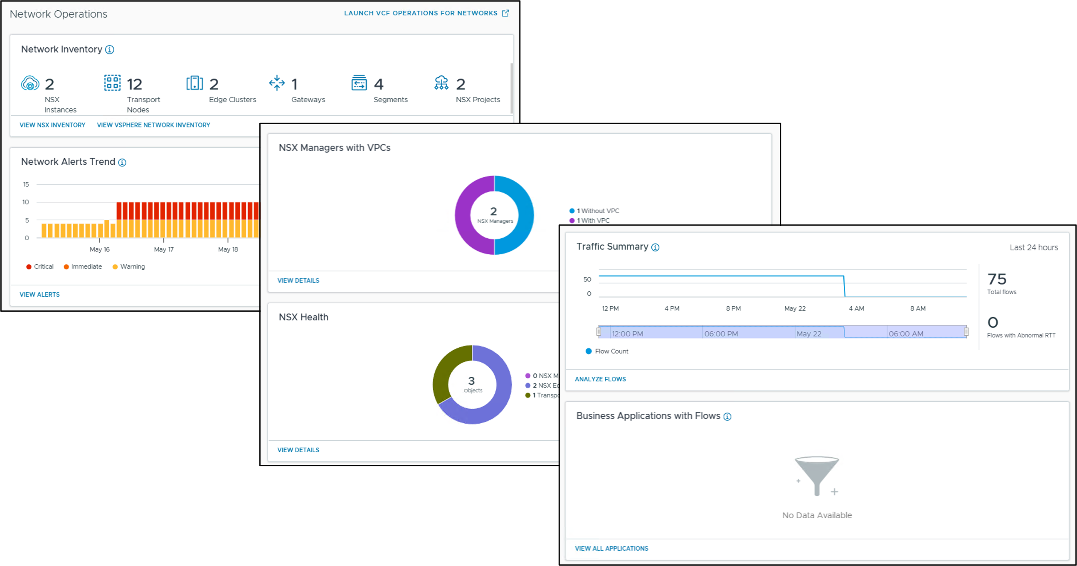
Network Operations Page
The Network Operations page includes several useful widgets that provide information about your deployments' networking status and resources.
Notes:
TalkTrack:
The Network Operations page includes several useful widgets. These widgets provide information on network deployment status and resources.
<End>

Slide 57
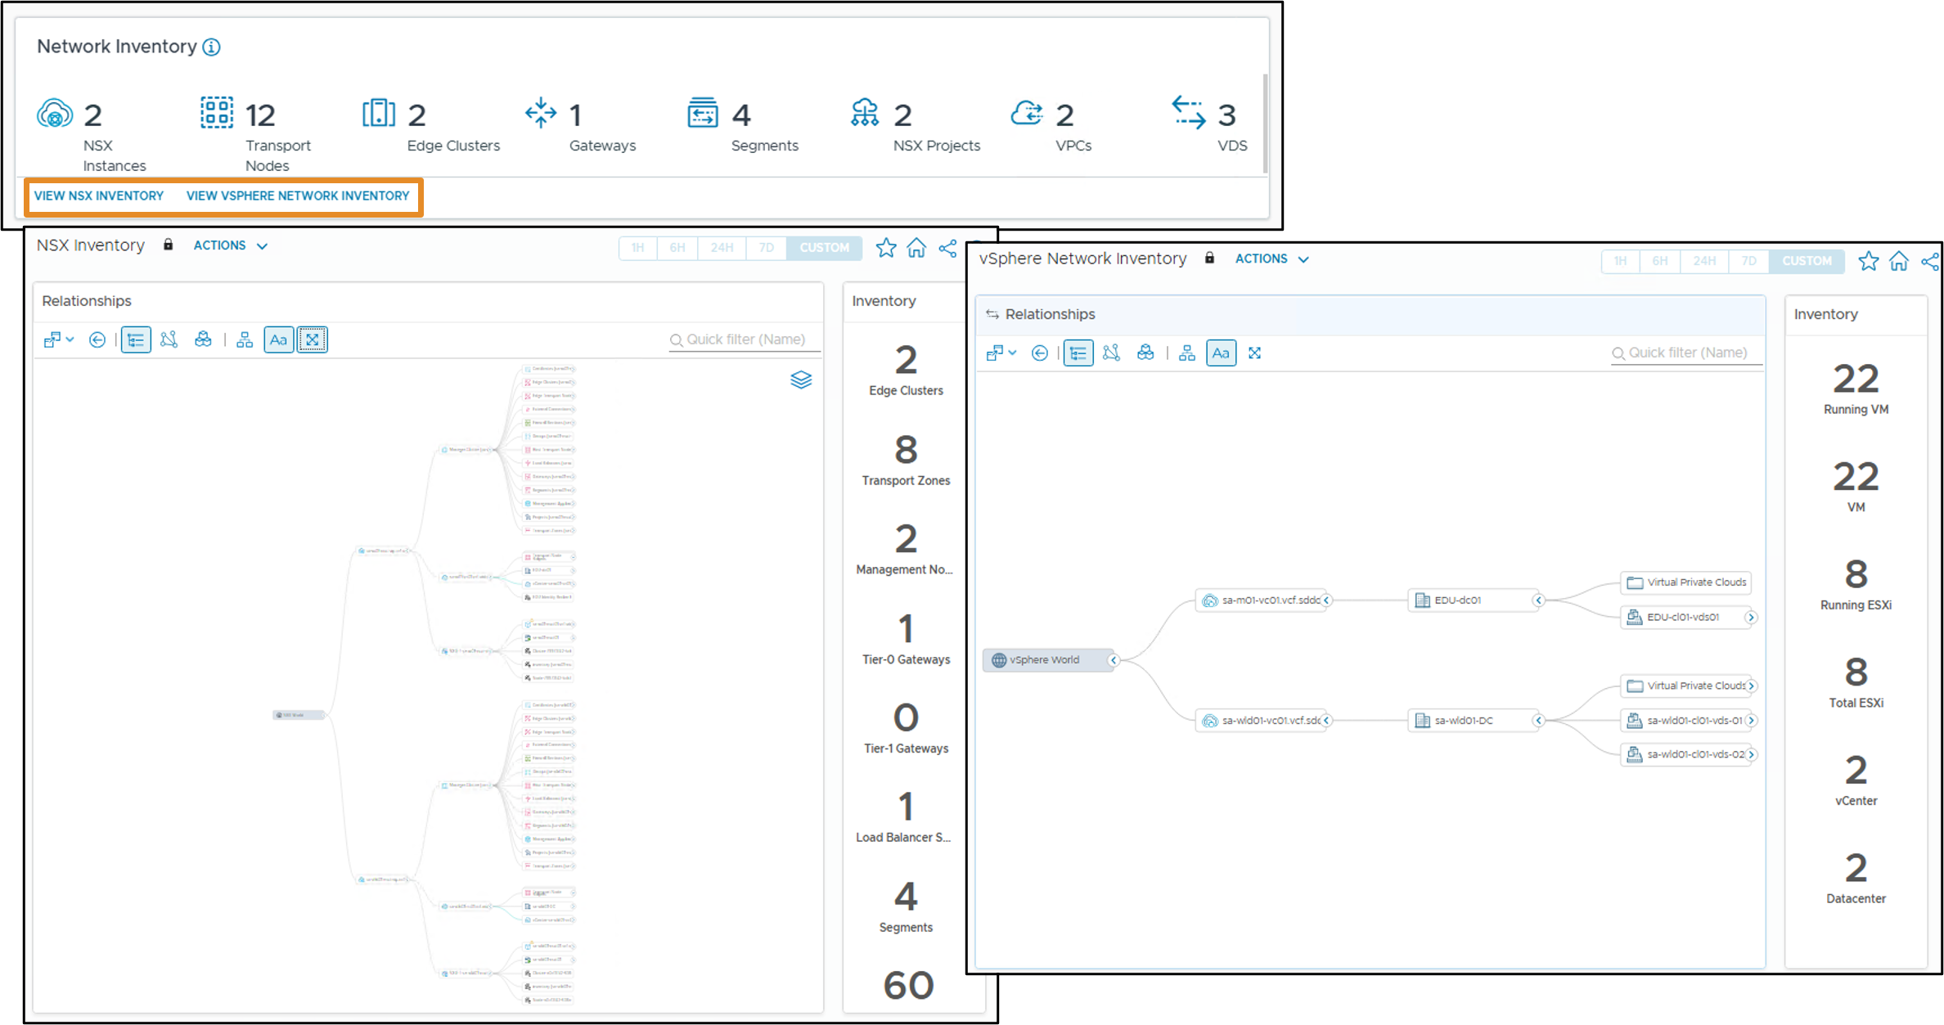
Networking Inventory Widget
The Networking Inventory widget includes the networking objects in your inventory such as NSX instances, transport nodes, and edge clusters.
Notes:
TalkTrack:
The Networking Inventory widget lists networking objects present in the inventory. These objects include NSX instances, transport nodes, and edge clusters.
<End>

Slide 58
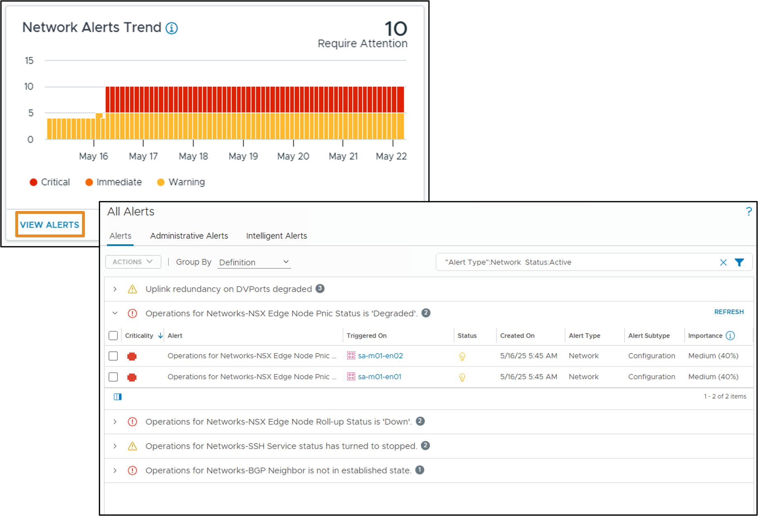
Network Alerts Widget
The Network Alerts widget includes a metric overview of the alerts in your environment.
Notes:
TalkTrack:
The Network Alerts widget provides a metric overview of alerts in the environment. The widget displays a trend of network alerts. There is an option to view all alerts, administrative alerts, and intelligent alerts.
<End>

Slide 59
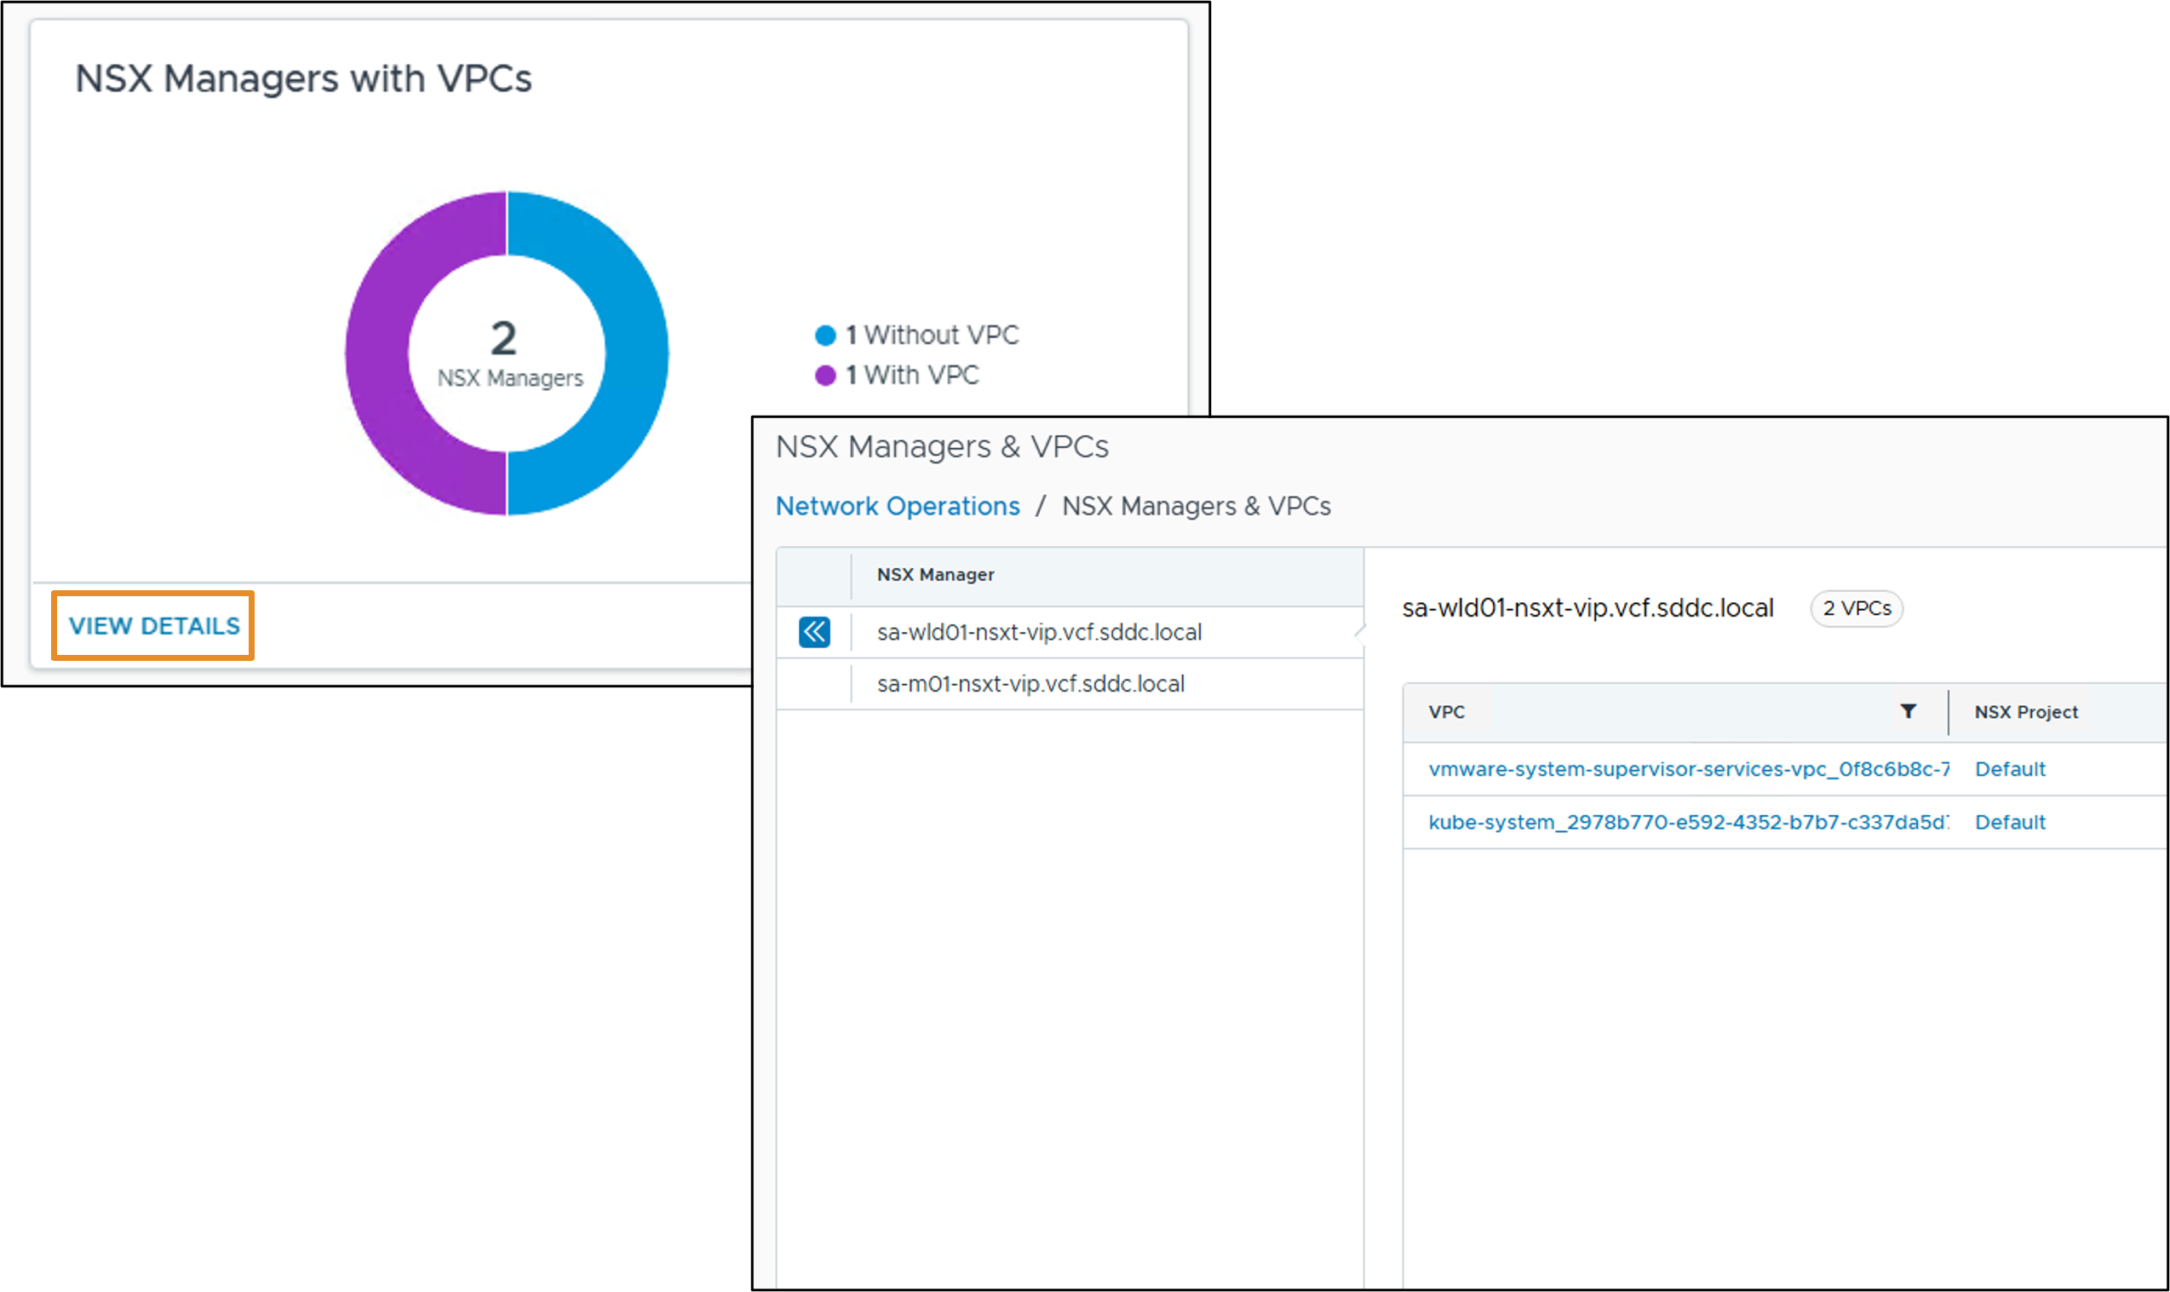
NSX Managers and VPCs Widget
The NSX Managers and VPCs widget includes information about the NSX Manager instances and the Virtual Private Clouds (VPCs) associated with them.
Notes:
TalkTrack:
The NSX Managers and VPCs widget presents information about NSX Managers and their associated Virtual Private Clouds. VCF Operations for networks provides enterprise administrators with comprehensive visibility into NSX Projects and Virtual Private Clouds included in data sources.
<End>
VCF Operations for networks provides Enterprise administrators with complete visibility to NSX Projects and VPCs included in data sources.

Slide 60
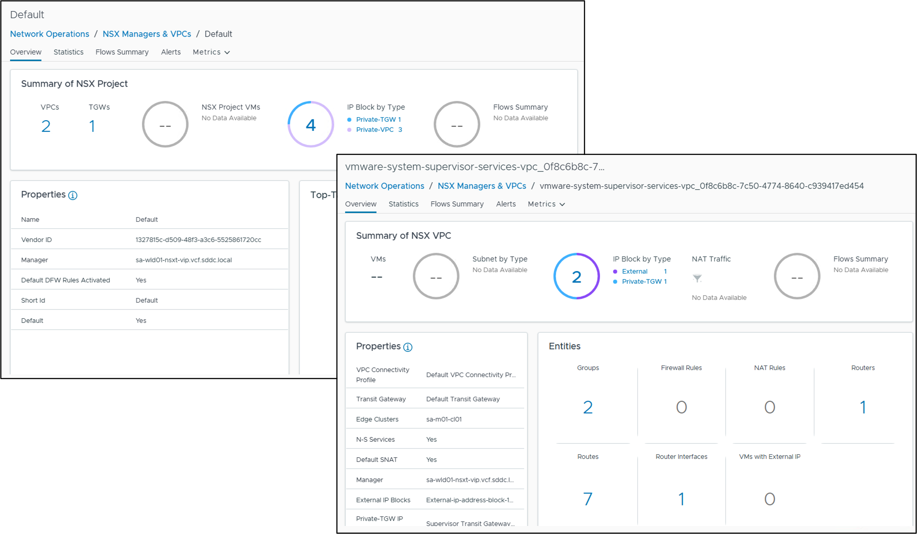
NSX Projects and VPC Details
You can use the data provided from Projects and VPCs to perform more granular analysis and troubleshooting of your NSX data sources.
Notes:
TalkTrack:
Data provided from projects and virtual private clouds (VPCs) allows for more granular analysis and troubleshooting of NSX data sources. A general overview of projects and virtual private clouds is available from the NSX Managers and VPCs widget on the Network Operations page in the VCF Operations Console. Selecting view details and expanding the entry for a given data source reveals the projects and virtual private clouds associated with it. Clicking on an entry for a project or virtual private cloud opens a dashboard page for that resource. To support efficient use of this feature, an increase in disk capacity for the VCF Operations for networks appliance is recommended. At least 500 GB should be added if the appliance is running at full capacity.
<End>
You can view a general overview of the Projects and VPCs from the NSX Managers and VPCs widget on the Network Operations page in the VCF Operations Console. By selecting View Details and expanding the entry for a given data source, you can view the Projects and VPCs associated with it. Clicking on the entry for a Project or VPC opens the dashboard page for that resource.
To support the efficient use of this feature, customers are recommended to increase the disk capacity of their VCF Operations for networks appliance by at least 500 GB if they are running at full capacity.

Slide 61
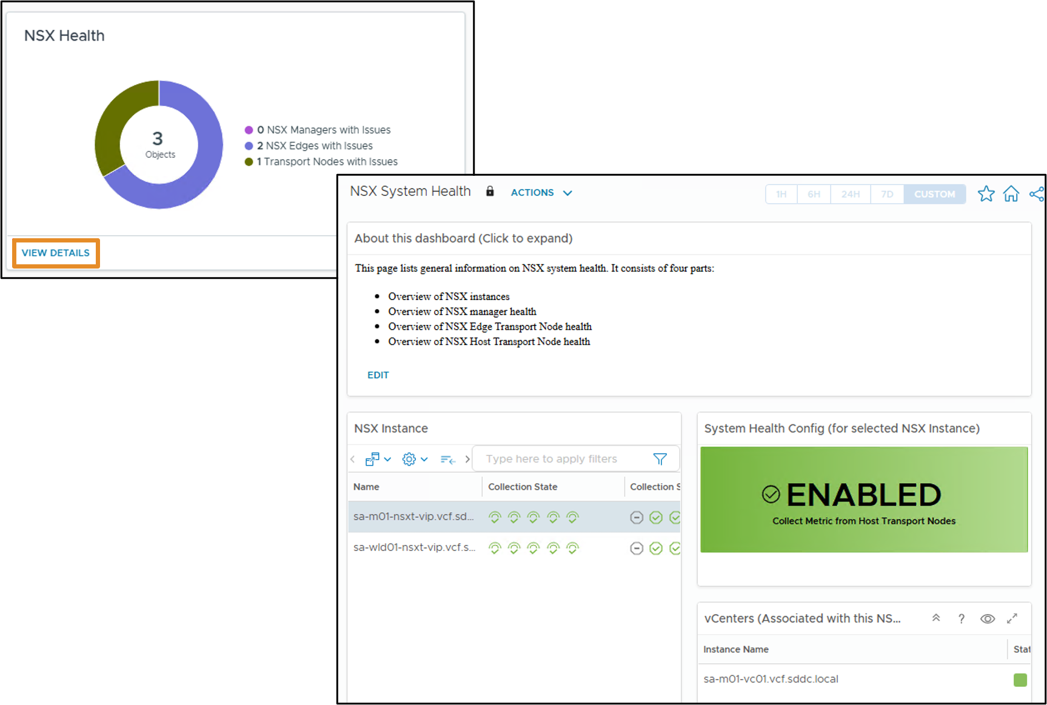
NSX Health Widget
The NSX Health widget includes information about any NSX Manager instances, transport nodes, or edge nodes, which are experiencing issues.
Notes:
TalkTrack:
The NSX Health widget presents information about any NSX Managers, transport nodes, or edge nodes experiencing issues. This dashboard provides general information on NSX system health, consisting of four parts: an overview of NSX instances, NSX Manager health, NSX Edge Transport Node health, and NSX Host Transport Node health.
<End>

Slide 62
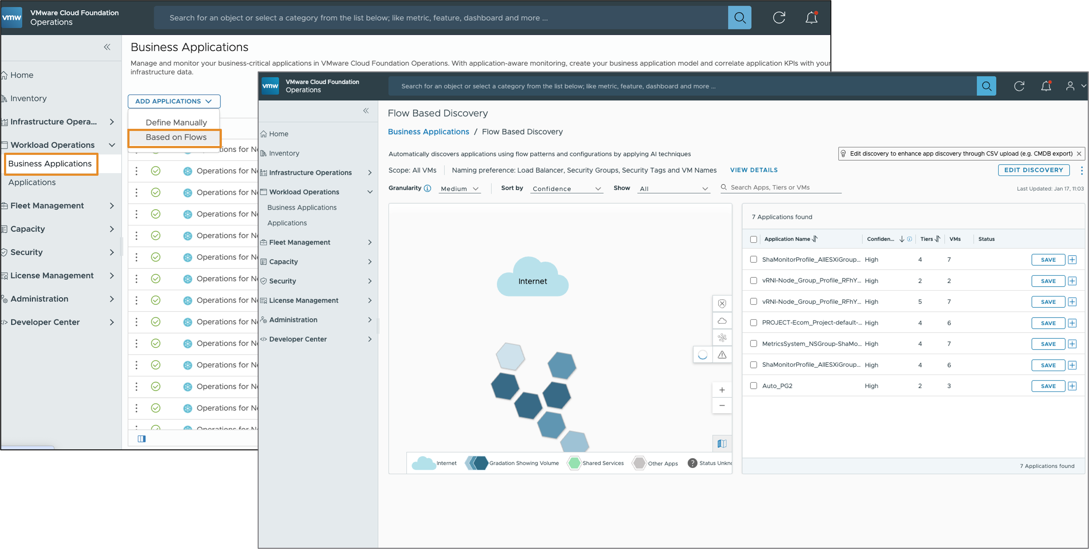
Business Applications Based on Flows
A Business Application is a container construct that represents a collection of interdependent hardware and software components that deliver a specific capability to support your business.
Notes:
TalkTrack:
A business application represents a collection of interdependent hardware and software components. These components work together to deliver a specific capability supporting business operations. The business application view shows how the performance of one object impacts others within the same application. This helps locate the source of a problem. For example, if an application encompassing the database, web, and network servers processing sales data shows a yellow or red status indicating degraded application health, investigation can pinpoint which server is causing the issue. VCF Operations can also display applications discovered through service discovery. Applications can also be imported from VCF Operations for networks.
<End>
The Business Application shows how the performance of one object affects other objects in the same Application, and helps you to locate the source of a problem. For example, if you have an application that includes all the database, Web, and network servers that process sales data for your business, you see a yellow, orange, or red status if the application health is degrading. From the Business Applications page, you can investigate which server is causing or exhibiting the problem.
VCF Operations can also display applications discovered through Service Discovery, and by importing applications from VCF Operations for networks.

Slide 63
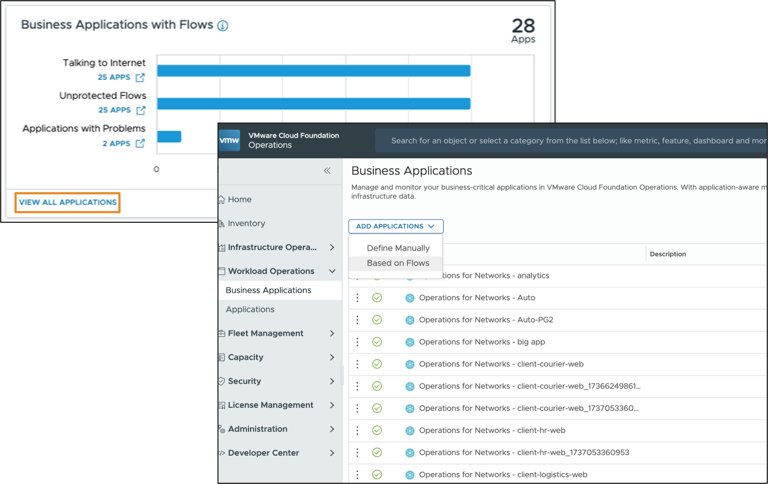
Business Applications with Flows Widget
The Business Applications with Flows widget includes information sourced from VCF Operations for networks, which is used for the flow analysis of your applications.
Notes:
TalkTrack:
The Business Applications with Flows widget includes information sourced from VCF Operations for networks. This information is used for flow analysis of applications. Only applications defined using the Operations Networks appliance are displayed.
<End>
Only applications defined using Operations-Networks appliance are shown.

Slide 64
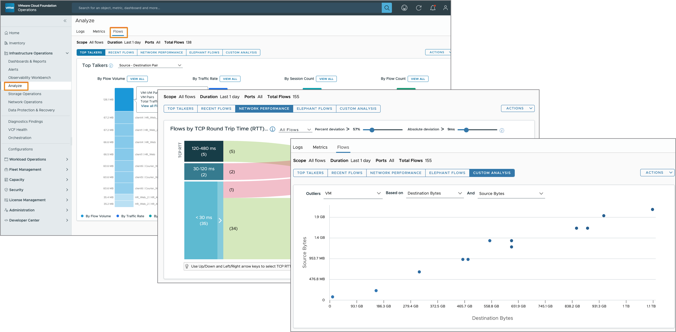
Flows in VCF Operations for networks
Flows provide an overview of entities contributing to the most traffic in the network and quick insight into network traffic with abnormal performance and recent changes.
Notes:
TalkTrack:
Flows in VCF Operations for networks provide an overview of entities contributing to network traffic. They also offer quick insight into network traffic with abnormal performance or recent changes. A flow is defined as a set of packets transmitted within a specific timeslot. These packets share the same 5-tuple values: source IP address, source port, destination IP address, destination port, and protocol.
<End>
A flow is defined as a set of packets transmitted in a specific timeslot, and sharing the same 5-tuple values - source IP address, source port, destination IP address, destination port, and protocol.

Slide 65
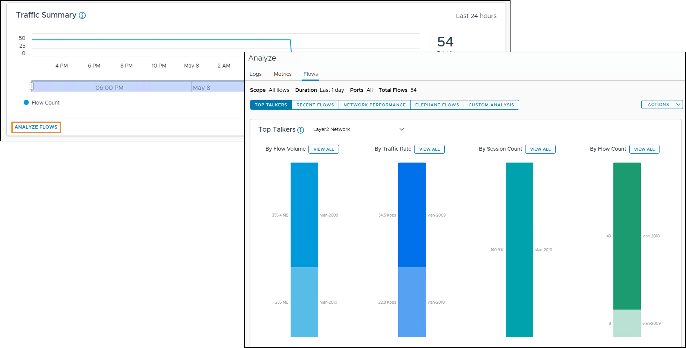
Traffic Summary Widget
The Traffic Summary widget includes an overview of the flow of traffic in your environment for the last 24 hours.
Notes:
TalkTrack:
The Traffic Summary widget offers an overview of network flow traffic in the environment over the past 24 hours.
<End>

Slide 66
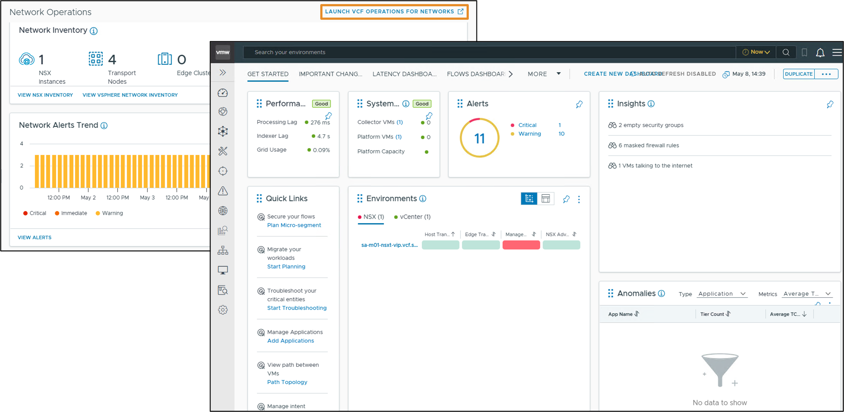
VCF Operations for Networks Home Page
The home page enables you to create, view, and manage dashboards in VCF Operations for networks.
Notes:
TalkTrack:
The homepage allows for creating, viewing, and managing dashboards within VCF Operations for networks.
<End>

Slide 67
Review of Learner Objectives
Describe the VCF Network Operations overview
Discuss the different widgets available in VCF Network Operations
Identify performance and health issues with the VCF Networking objects

